Slide 1
Do NOW
Which is the hottest layer of the earth and the source of heat for mantle convection?
2. Describe the three main types of plate boundaries. What kind of geographical features do they create?
3. Calculate the scale of a map of California if 100 cm on the map indicate an actual distance of 100,000 cm on the ground.

Slide 2
Agenda :
Do Now/ Do Next
Recap task : mathematical modeling of the earth’s interior
Continue working on data/ read and annotate article
Graph data on Spreadsheet
Data analysis
Discuss Lab report format ( HW)
Summit PLT
Exit Ticket on Weebly

Slide 3
Recap
Summarize the earth composition lab.
What are we trying to prove?
What kind of model are you building?
What data are seismologists working with? What data are theoreticians working with?

Slide 4
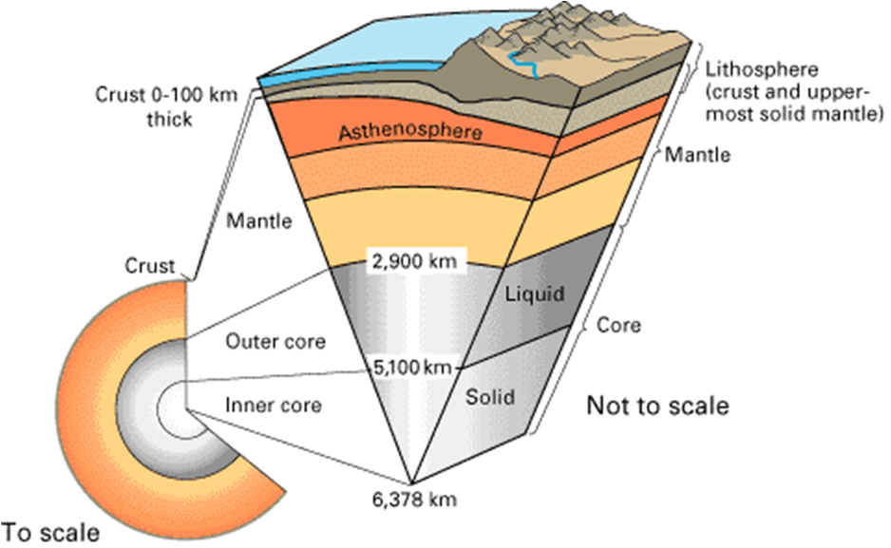

Slide 5
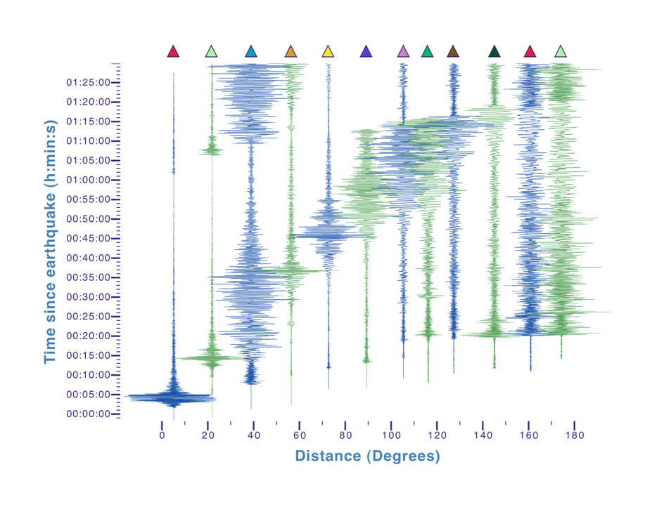
Seismologists use real data

Slide 6
Seismologists checklist
Obtain seismogram
Read and interpret information on the graph
Record distance in degrees Vs Time of arrival of P-Waves in data table from graph
Graph that data on a spreadsheet.( Go to link on Weebly. Click on File, make a copy, erase data and enter your own )

Slide 7
Check your understanding….
What are the seismologists studying?
What observations did you note down?
What will be your next step?

Slide 8
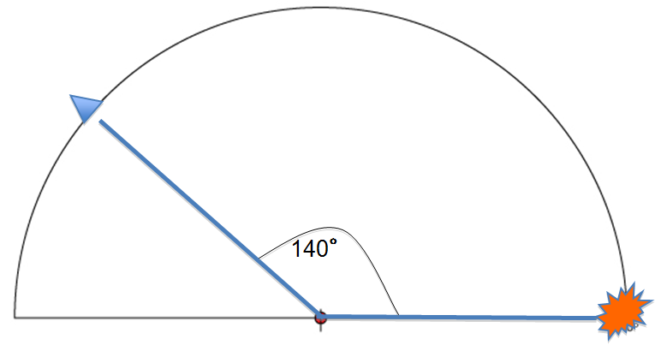
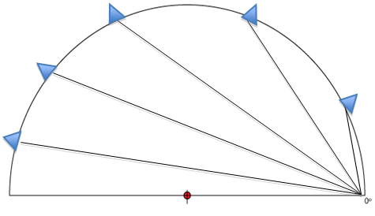
Theoreticians calculate arrival time of P-Waves

Slide 10
Calculating the model scale
Radius of your model =
Actual radius of the earth =
Calculating the scale :

Slide 11
Speed of the p waves
The theoreticians assume the p-waves travel at the same speed everywhere!!
11 Km/s
!!!!!!!!!!!!!!!!!!!!!!!!!!!!!!!!!!!!!!!!!!!!!!!!!!!!!!!!!!!!!!

Slide 12
Two scenarios
Theoreticians’ data match the seismologists’ data.
What does that mean?
A uniform earth
2. The theoretical and observed data do not match!
Layered earth!!!

Slide 13
Theoretician’s checklist
Position seismographs on model earth randomly and measure their distance from the epicenter using geocentric angles
Connect them to the epicenter on model
Measure distance and record
Calculate model scale
Calculate actual distance by multiplying with scale factor
Calculate p wave arrival times by assuming a speed of 11 Km/s
In your group’s spreadsheet , graph distance in degrees Vs arrival time data

Slide 14
Seismologists : Read and annotate article
While waiting for theoreticians to complete their model data
Highlight, circle, underline important information. Questions/comments on margin.
On paper, write down the main idea ( summary ).
What is one application of seismic technology in the real world?

Slide 15
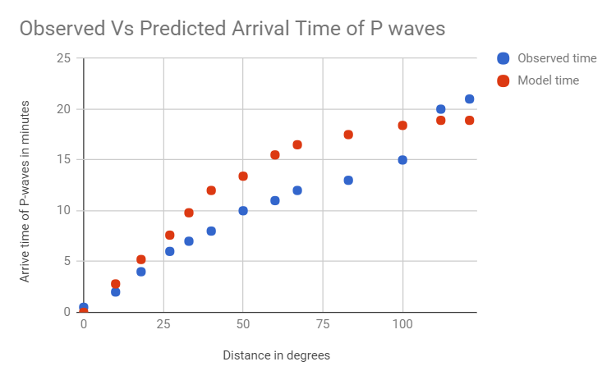

Slide 16
Data Analysis
What Trend do you see in the data?
Describe the trend in the model data ( theoreticians)
Describe the trend in observed data ( seismologists)
Are they similar/different? What does that imply?

Slide 17
Lab report: Earth Composition Lab ( HW )
Refer to your worksheets.
Write up format is same as before,
Background
Objective
Procedure
Data ( Include data table and an approximate sketch of your graph )
Analysis ( answer the questions on the back of your worksheet )

Slide 18
SUMMIT PLT Energy Changes 2
If you have completed your worksheet, please submit it and get approved for content assessment.
If not, continue working on it. Objectives 1, 3. Use all resources on summit to complete worksheet.

