Slide 1
Unit 1 Review
Energy Diagrams

Slide 2
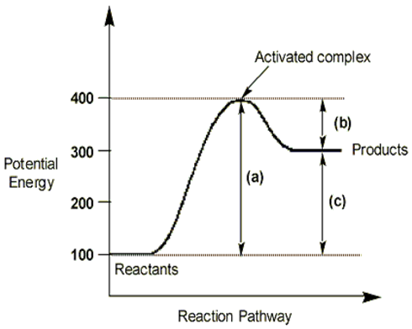
What is the potential energy that the reactants start with?
What is the activation energy?
What energy do the products end up with?
Is this an exothermic or an endothermic reaction?
What is the enthalpy?
What would the thermometer show if we measured the surrounding temp for this reaction?

Slide 3
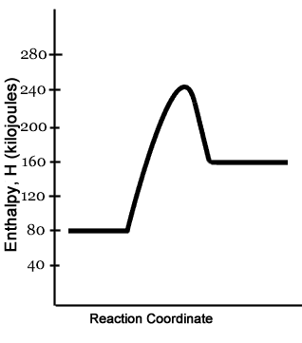
Label this energy diagram.

Slide 4
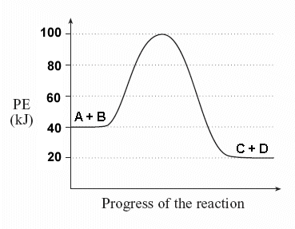
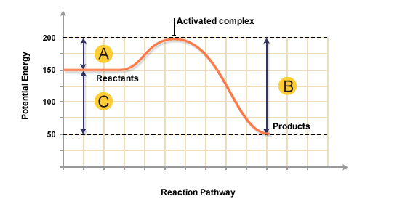
Which one would be a better firework?

Slide 5
Sketch a potential energy diagram :
Reaction: A + B = C + D
Given that ΔH = -10 kJ and E_{a} = +40 kJ

Slide 6
Draw and label a potential energy diagram:
The following reaction has an activation energy of 120kJ and a ΔH of 113kJ. 2NO₂ = 2NO + O₂

Slide 7
Answer in complete sentences:
1.Which type of reaction requires higher activation energy, endo or exo?
2. Why do endothermic reactions show a temperature drop and exothermic reactions show an increase in surrounding temp?

