Slide 1
DO NOW ( Have all HW out on desk. Solved problems, reading notes and CER. If all not there, L.D)
1. If a sample of water weighing 20 g heats up from 25 to 45 degree C when heated by a bunsen burner for 5 minutes, how much thermal energy does it absorb? The specific heat of water is 1 cal/g deg C. Use proper format and units in your solution.
2. What does the zeroth law of thermodynamics say? Write in your own words.
Do Next on Weebly.

Slide 3
HEAT and ENERGY
IN THE EARTH SYSTEM
UNIT II

Slide 4
NOTES
VOCABULARY

Slide 5
THERMO-DYNAMICS!!
THERMO= HEAT DYNAMICS = MOVEMENT
MOVEMENT OF HEAT DEEP INSIDE THE EARTH CAUSE VOLCANOES AND EARTHQUAKES, RESHAPES THE SURFACE
Heat is a form of energy that moves the tectonic plates and causes seismic upheavals

Slide 6
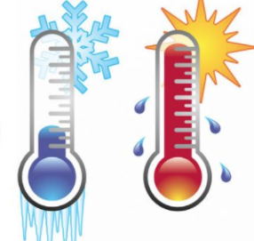
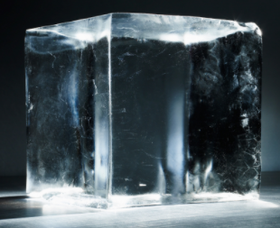
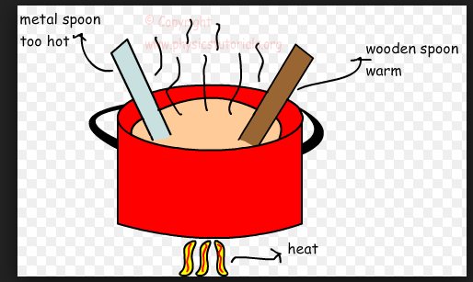
What are the factors that affect heat flow (Q) ?
VS.

Slide 7
What are the modes of heat transfer?
CONDUCTION
CONVECTION
RADIATION

Slide 8
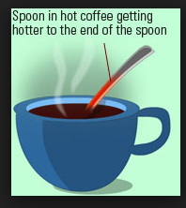
CONDUCTION

Slide 9
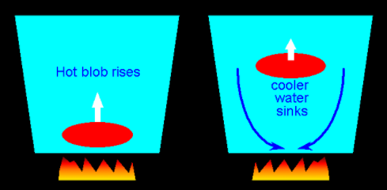
CONVECTION

Slide 10
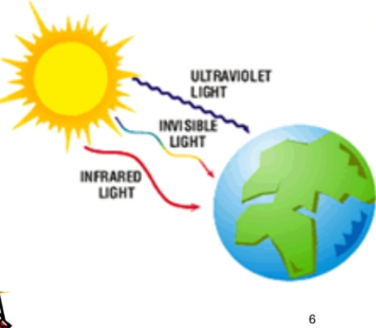
RADIATION

Slide 11
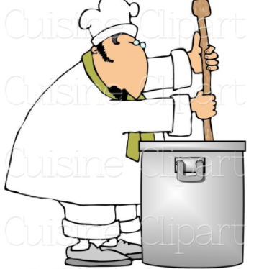
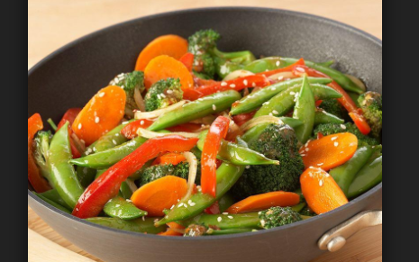
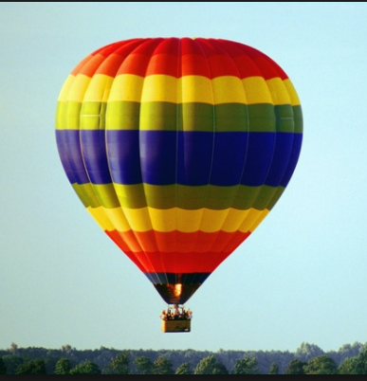
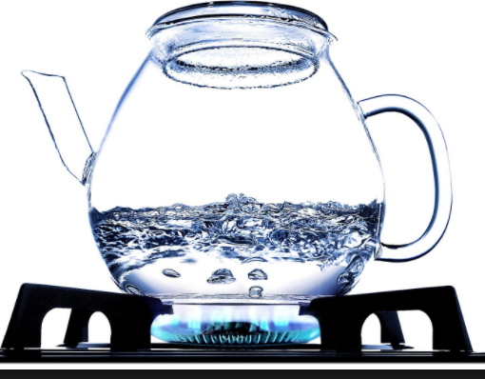
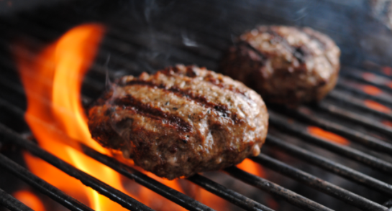
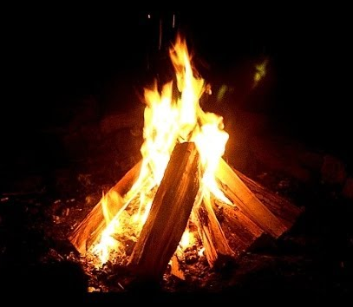
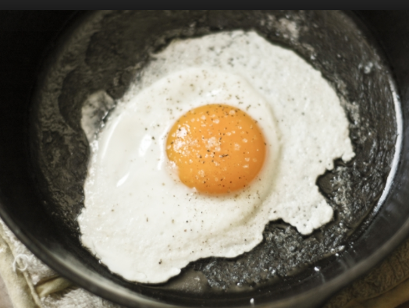
Identify the mode of heat transfer

Slide 12
Deep inside the earth how does heat move?

Slide 13
Does Cold exist?
Which way does heat flow?
Does anything called ‘cold’ exist in science?

Slide 14
NOW LET’S TALK ABOUT ENERGY
Of which thermal energy or HEAT is a category.
What is energy again??
The __________ of doing ________.
What are the different types of energy?? There are various kinds, all of which can fall under two categories : potential and kinetic.

Slide 15
RECAP THE PROCESS OF DIGESTION
If a piece of meat contains chemical potential energy of 500 Calories, when you eat it, do you actually GET 500 Calories?
Turn and talk with your group!
Explain your answer!

Slide 16
The correct answer is NO
We actually get less than the total energy content of any food we eat.
This is due to the FIRST LAW of Thermodynamics.

Slide 17
THE FIRST LAW
All system at a state of equilibrium, possess some INTERNAL ENERGY ( U).
The change in internal energy of a system = Heat going into the system - Work done by the system
How can this explain why we get less energy from food we eat?

Slide 18
RESTATING THE FIRST LAW
THE LAW OF CONSERVATION OF ENERGY :: ENERGY CANNOT BE CREATED OR DESTROYED, BUT CAN ONLY BE CONVERTED FROM ONE FORM TO ANOTHER.

Slide 19
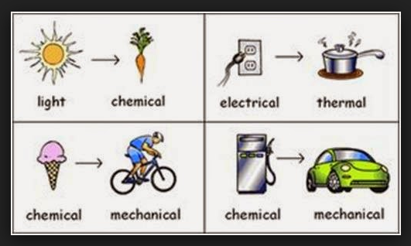
What are some energy transformations we see everyday?

Slide 20
Potential Energy
Energy due to the position of an object.
P.E. = m. g. h
So the higher an object is situated, the more potential energy it has.
Potential energy may also be in food, or fuel as chemical potential energy.
There is mechanical potential energy in a set of gears.
Gravitational Potential Energy exist on a ball suspended in mid air.
Nuclear potential energy exists in all atomic nuclei

Slide 21
Kinetic Energy
Energy of motion. When you do jumping jacks, the chemical potential energy of the food you ate converts to kinetic energy due to your movement and ultimately to thermal energy as you start feeling hot. There are various forms of kinetic energy as radiant energy, thermal energy, sound waves and electrical energy.
K.E. = o.5 m.v²

Slide 22
Newton’s Cradle
CLAIM: In the newton’s cradle apparatus, energy is being conserved, at the same time changing forms
EVIDENCE: What do you see?
REASONING: What explains it? What kind of energy transformations are happening?

Slide 23
CLAIM | EVIDENCE | REASONING
In the newton’s cradle apparatus, energy is being conserved, at the same time changing forms

Slide 24
The Law of conservation of energy

Slide 25
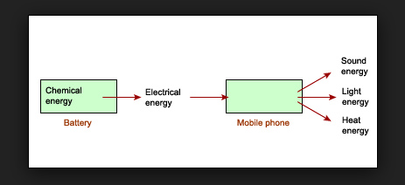
Energy Stories
What is the energy story of your cell phone?

Slide 26
Energy Stories Poster : 30 minutes
Work in groups of two
You will be researching the topic given to you to learn what energy transformations are involved in that topic
You will be creating a poster in an A4 size paper. Include all the different energy transformations involved, a simple diagram and explain how the first law applies to your topic ( Explain total internal energy, heat and work in your context. Also talk about how the law of conservation of energy applies). You may want to extend your research to finding conversion efficiencies!

Slide 27
Energy Stories : Grading Rubric on Weebly
Hydroelectric Power Generation A roller coaster
The food web Solar panels
An electric car ( Eg. Tesla ) A steam engine
A nuclear power plant A wind mill
Growing corn Geothermal Power
A refrigerator A computer/tablet
ICE Cars ( Eg. A Dodge Demon ) Thermal Power Plants
A fireworks display

Slide 28
FIRST LAW MATH

Slide 29
EXAMPLE PROBLEM
The internal energy of a system decreases by 200J. If 50 J of work is done BY the gas, how much energy is transferred as heat? Is the work done positive or negative?
Given : Internal energy change = 200 J; Work done by gas (system) = 50 J
Required: Q = ?
Solution : -200 J = Q - 50 J
Q = -150 J

Slide 30
Let’s use Google Sheets to build a model
Create a new google sheet and name it ‘First law’
There will be three sheets for the three first law variables. What are those?
Insert symbol to insert the symbol for delta
How can we solve for one unknown at one particular time? We should know the other variables in the equation. It is important to sort the problem into given and required categories for this purpose
Now follow my example and set up your spreadsheet to calculate the unknown variable in the first example.

Slide 31
First Law Practice Problems
900 joules of heat are added to a system and 200 joules of work are done on the system. What is U?
Calculate w for a system that absorbs 260 kJ of heat and for which E = 157 kJ. Is the work done on or by the system? Does the system expand or contract?
3000 J of heat is added to a system while 2000 J of work is done on the system. What is the change in internal energy?

