Slide 1
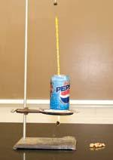
DO NOW
This is what the calorimeter you built last week should look like
What is one drawback for this built calorimeter vs the one the simulation was using?
Hint :Think back to the coffee cup calorimeter.
2. If a cheeseburger gives you 980 calories of energy, how much increase in temperature would it cause to 50g of water? The specific heat of water is 1
(Cal/g deg.C)
DO NEXT review your vocab at http://tinyurl.com/ya7ov3co
Also on Weebly (Digital Agenda)
Notes:
10 minutes for solving both problems (students), attendance

Slide 2
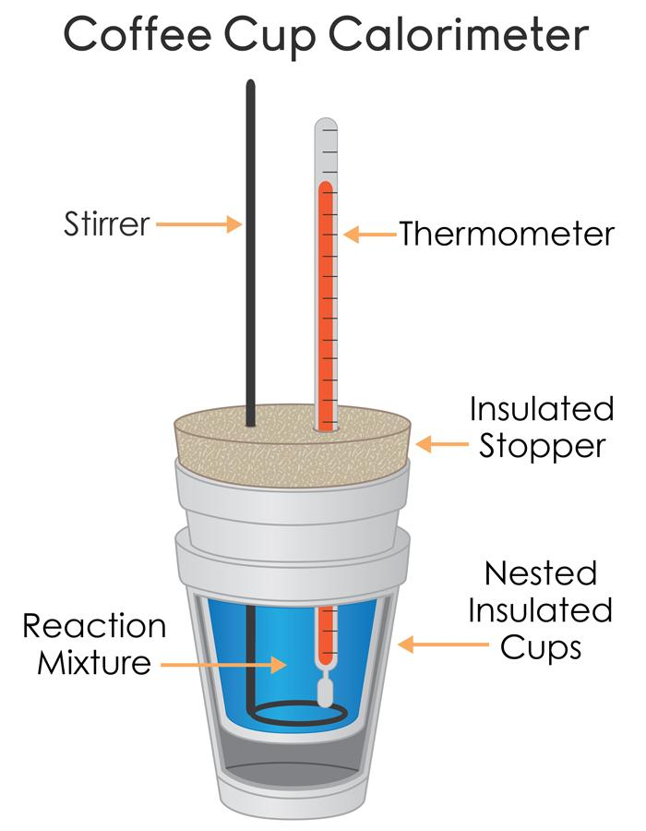
What is the function of the insulated stopper?
Insulation is something that prevents heat movement!!

Slide 3
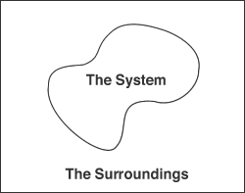

Slide 4
Solving problems in chem
Given: Cheeseburger gives you 980 calories (Q) Mass of water is 50g (m) Specific heat of water (C) = 1 cal/g deg C | Required: 🔺t =?? | Solution: Q = m C 🔺t 980 = 50. 1. 🔺t 🔺t = 980 / 50 🔺t = 19.6 degree Celsius

Slide 5
How do the units work??
Q is in calories , m is in grams and unit of specific heat is calories/gm deg.C
When we divide Q by (m.C), we get
Save your Do Now Worksheet in your binders and use as example when reviewing.
Notes:
5 minutes for recap, discussion and solving both do now probs. Students take notes on problem solving method.

Slide 6
Modeling chemical reactions
Zooming in!!!

Slide 7
Get ready for taking and saving your notes
Everything’s important !!

Slide 8
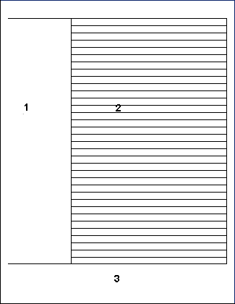
Taking notes...it’s vital!!
Date
Main ideas
Keywords
Important details
Formula/equation
Diagrams
Objectives
Topic
Questions ( after taking notes)
Place your daily notes in your binder , in the notes and handouts section.
Summary

Slide 9
Today’s objectives
Create molecular models of chemical reactions
Describe and graph the energy changes that occur in the reactions

Slide 10
1.The food eaten
2. The food in the sample cup of the calorimeter
The human body
The water in the calorimeter

Slide 11
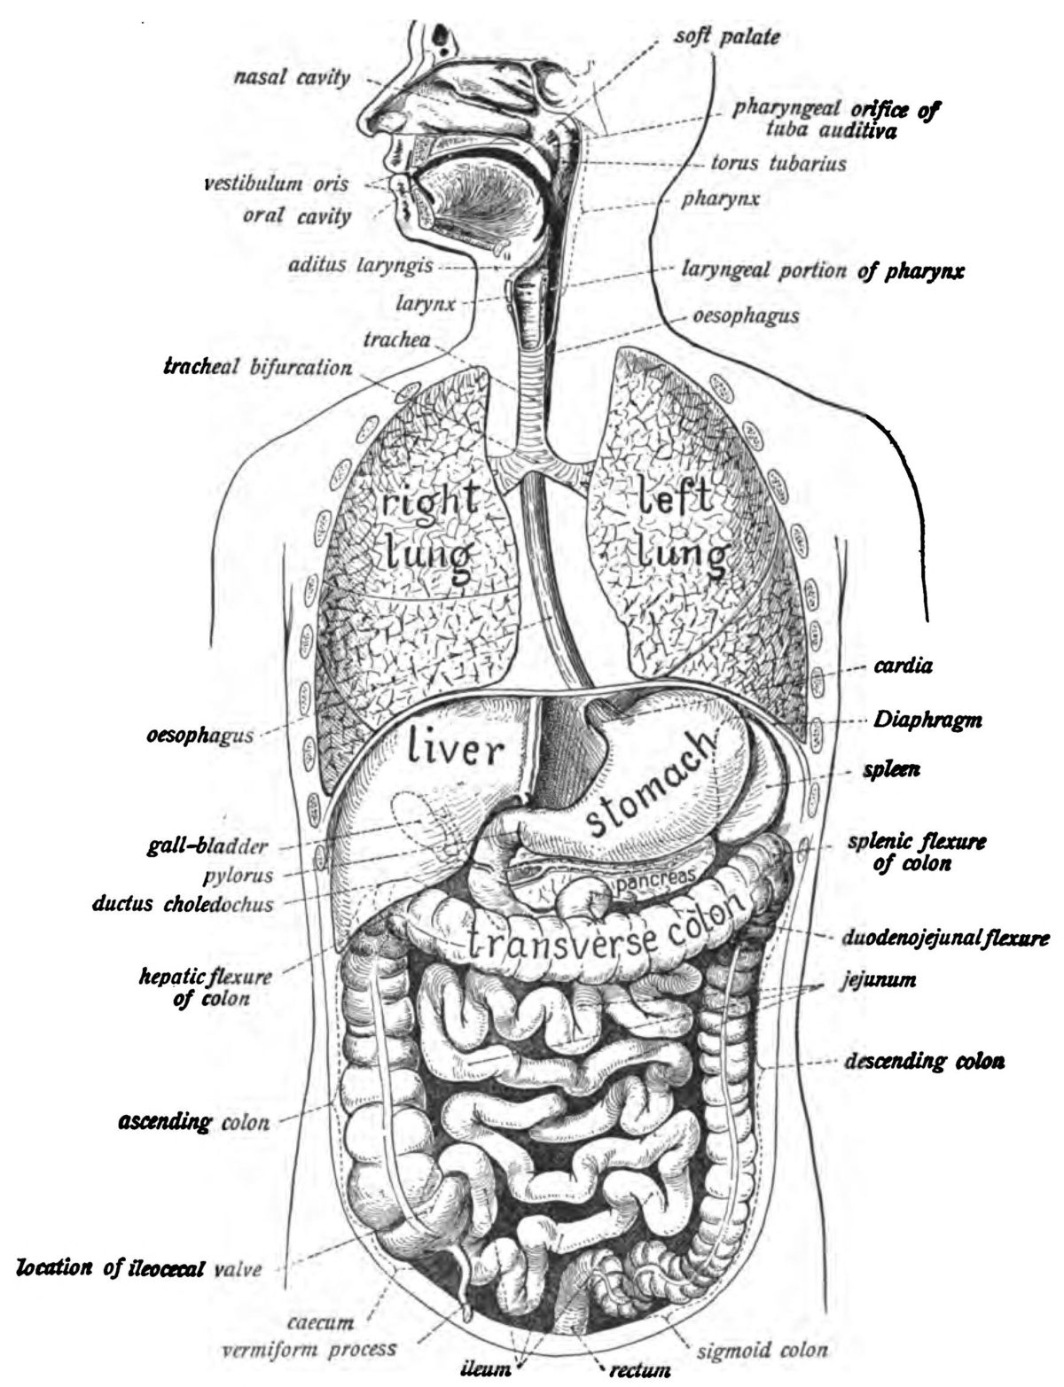
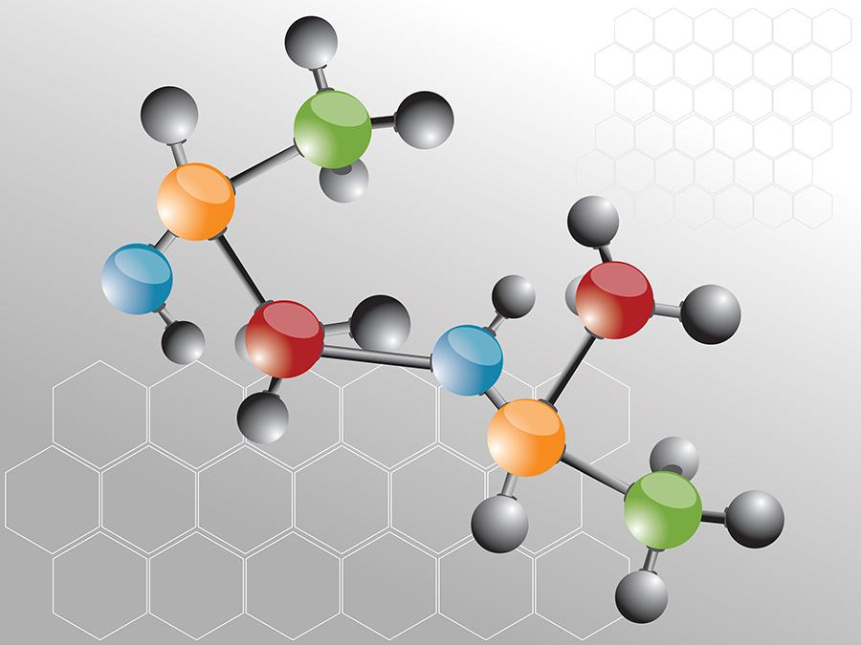
Zooming in……..
Notes:
5 minutes to recap and link the concept of system and surrounding to all chemical reactions.
What goes on at the molecular level?

Slide 12
THE THREE LEVELS OF ZOOM (ING IN)
SYSTEM
ENERGY
ATOMS/MOLECULES

Slide 13
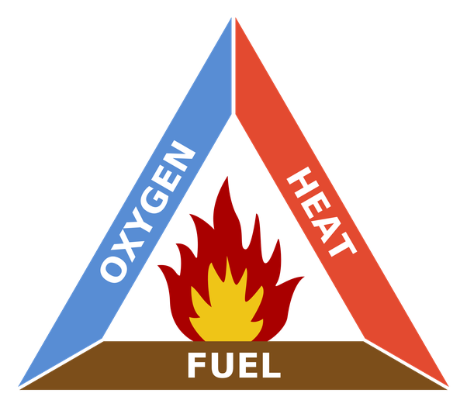
QUICK RECAP...what is combustion?
C_{X}H_{Y} + O₂ = CO₂ + H₂O - 🔺 H
A chemical change
What happens to atoms and molecules
in a chemical reaction?
The chemical reaction is the system
Notes:
Chemical reaction demo with food color, water and bleach

Slide 14
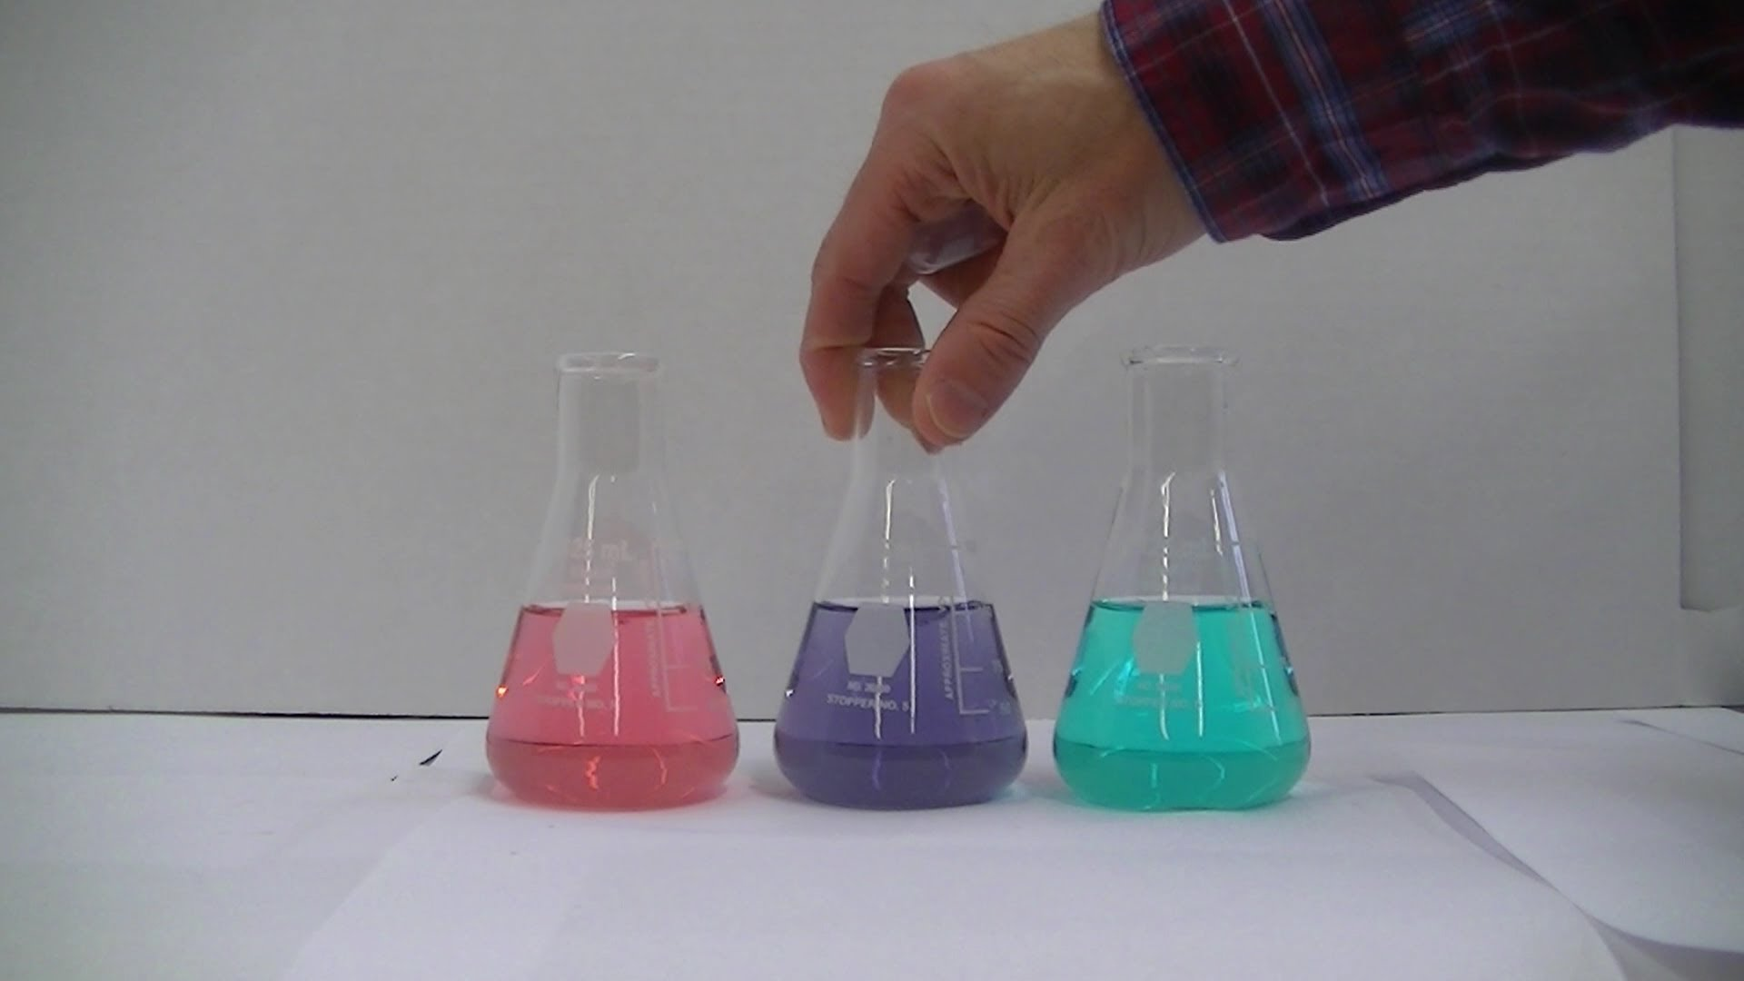
Let’s talk demo
What goes on in a chemical reaction??
Notes:
Demo: 7 minutes

Slide 15
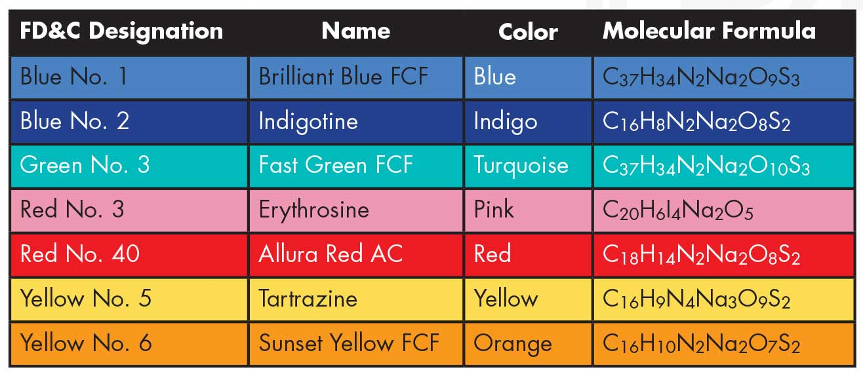

Slide 16
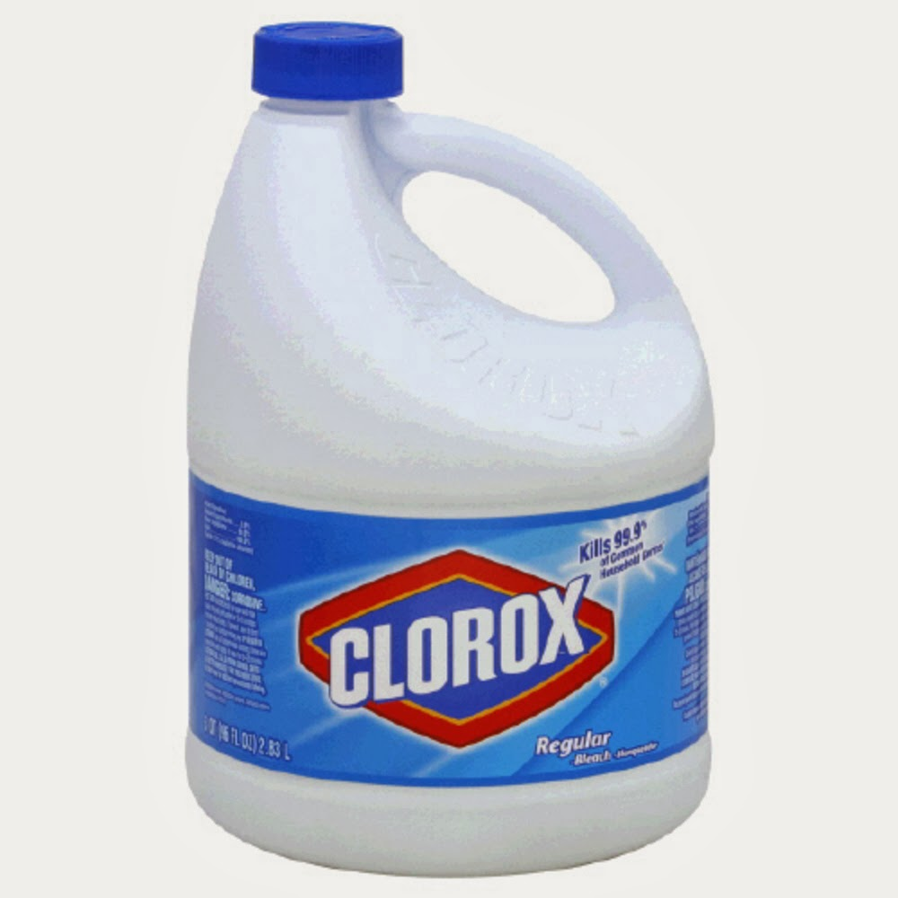
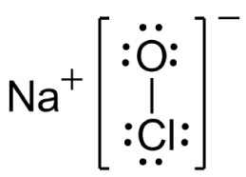

Slide 17
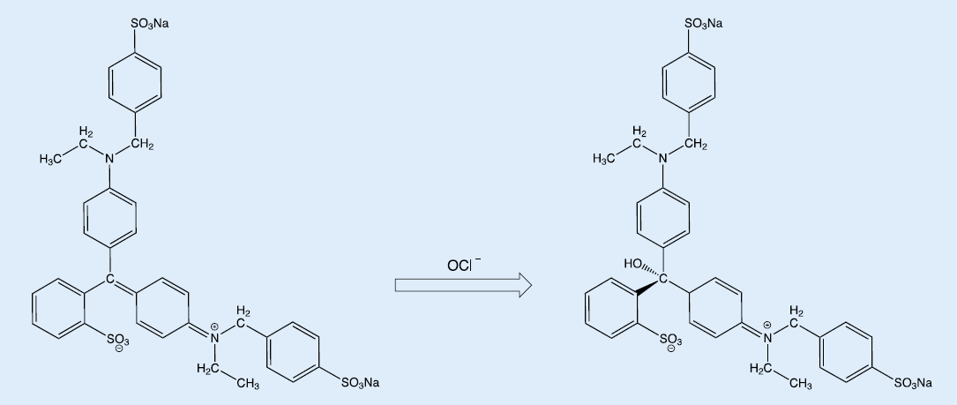
Notes:
Debrief 3 min

Slide 18
Modeling an exothermic rxn at the molecular level
2C₂H₆+ 7O₂ = 4CO₂ + 6H₂O - 🔺H
How many elements are present?
Use a single color to represent an element from your M&M stash
Create an M&M equation ( use colored pens or markers to indicate energy going in or out and enthalpy going in or out of the system.
Now replace your M&Ms with pictures of molecules and eat ‘em!!
Reactants
Products
Enthalpy
Notes:
Modeling instructions/ pass out materials 5 min
Student collaborative work time for both endo and exothermic reactions: 15 minutes

Slide 19
Now do it for endothermic reactions!
N_{2(g)} + O_{2(g)} →→ 2NO_{(g).}
The reaction absorbs about 180.5 KJ of energy from the surroundings. ( HINT: that’s the enthalpy!!)

Slide 20
Test drive your model
Sim Link
www.griffinchem.weebly.com
You might need this picture for tonight’s homework!!
Notes:
Students verify their models with sim 5 minutes

Slide 21
Let us graph the energy changes…...
THIS IS SUPER IMPORTANT..YOU WANT TO PAY CLOSE ATTENTION

Slide 22
Energy diagrams!!
Potential
Energy
Progress of reaction
Notes:
Create energy diagrams with spiraling feedback from students 7 minutes

Slide 23
Energy diagrams!!
Potential
Energy
Progress of reaction

Slide 24
Brainstorm about your assigned chemical reactions
Collaborative. Make your own poster
What kind of a reaction is it?
Write down the equation ( Write down the reactants and products, Show which way the energy goes in or comes out, label the enthalpy with the correct sign)
Draw and label an energy diagram
Present to the class
Time allotment : 30 minutes. Discuss with team: 10 min. First draft 10 min. Poster creation 10 min.
Notes:
Describe task. Distribute index cards w/reactions, poster paper 5 min
Student work time30 minutes
Presentation time/Gallery walk for 8 groups 16 min

Slide 25
Exit ticket
Which type of reaction needs more activation energy?
2. Explain the sign convention for enthalpy in chemical reactions.

Slide 26
ADD ONS
If you are done, go to https://www.khanacademy.org/test-prep/mcat/chemical-processes/thermochemistry/a/endothermic-vs-exothermic-reactions
Check Weebly for URL
Read and take notes. Complete with Enthalpy WS in homework.
Homework : Enthalpy worksheet.
Notes:
Distribute/describe HW 5 min. Students read HW ask questions 5 min. Exit ticket 5 min
Students read and take notes last 10-15 min ( if time is left )

