Slide 1
DO NOW
Take out the signed safety Contract that’s due today
TAKE THE SAFETY QUIZ
Do not Talk to each other while you take the test.
DO NEXT
VOCAB REVIEW ON WEEBLY

Slide 2
Agenda
Discussion of CER
Correct Endo- Exo Worksheet
Review work : SPEED BUILDERS!!
Create your group’s energy diagram posters

Slide 3
 | 4 | 3 | 2 | 1
Claim (Argument) | Provides a clear, strong claim. | Provides a clear, reasonable claim. | Claim is present but not clear. | There is no claim or claim is not relevant to the topic.
Evidence (Support) | Evidence is sufficient and strategically selected to support the claim. | Evidence is sufficient and supports the claim. | Evidence insufficient, or misaligned to the claim. | No evidence or little evidence provided to support the claim.
Analysis/ Link/ Reasoning | Explanation of evidence provided is clear, accurate, and convincing | Explanation of evidence provided is clear and accurate | Explanation of evidence is inadequate or inconsistent | Explanation of evidence is missing or inaccurate

Slide 4
Claim: I was sick.That’s why I could not attend school last week.

Slide 5
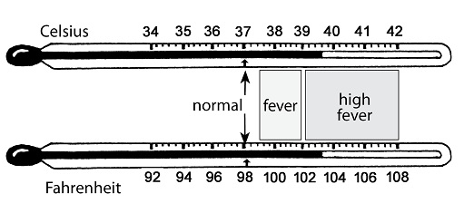
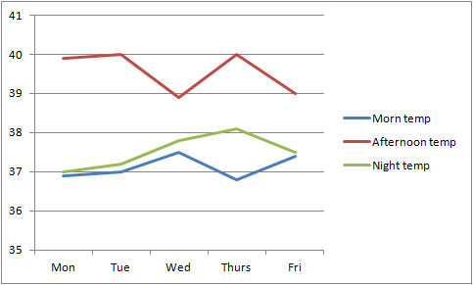
EVIDENCE
Body
Temp in
Celsius

Slide 6
Reasoning?

Slide 7
Claim : a conclusion to the question or problem a. The combustion of the food samples was an exothermic reaction, with release of heat to the surrounding b. The combustion of the food sample was an endothermic reaction, absorbing heat from the surrounding.

Slide 8
Evidence : Scientific data that supports the claim Readout Calories from a sample of 130 g of beef is 340 calories. This is calculated using the equation Q = m c Δt, where Q is the heat in calories, m is mass of water in gm, c is specific heat of water (1 cal./gm °C) and Δt is the temperature difference ( final temperature of water – initial temperature of water ). Q = m c Δt = 340 calories | Reasoning

Slide 9
Endo- Exo Worksheet
Take your worksheet and a piece of paper out

Slide 10
OBJECTIVES
SWBAT GRAPH the energy changes associated with endothermic and exothermic chemical reactions.
REMINDER : TAKE NOTES

Slide 11
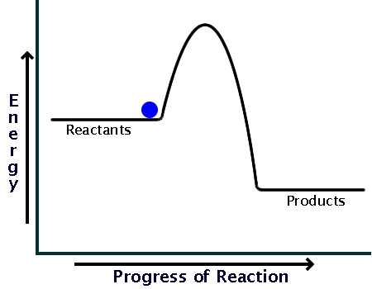
At the beginning of the reaction there are reactants with certain energy

Slide 12
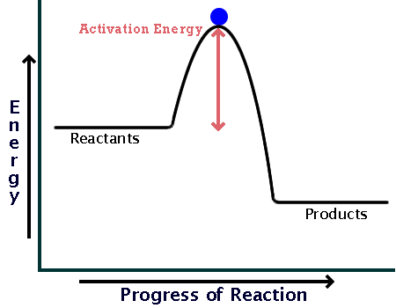
In order for the reaction to occur Activation Energy needs to be reached.
Activation energy (E_{a}) = minimum amount of energy to start a reaction.
The more energy needed to start a reaction, the higher the activation energy.
Notes:
12

Slide 13
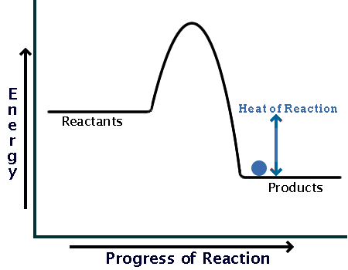
At the end of the reaction there are products with certain energy

Slide 14
∆H = difference in energy of reactants & products
Time vs. energy
Energy
}
Reactants
ΔH
Products
Time
- If ΔH is positive the reaction is Endothermic
- If ΔH is negative the reaction is Exothermic

Slide 15
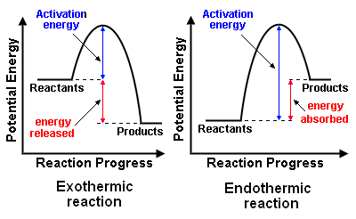
Exothermic vs. Endothermic

Slide 16
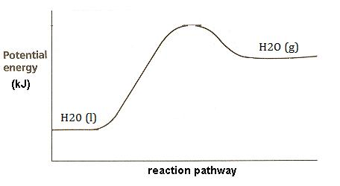
For example… The evaporation of water
H₂O (l) → H₂O (g)
Does this reaction require a little or a lot of energy to start?
Does this reaction have a positive or negative ΔH?
Is this reaction exothermic or endothermic?

Slide 17
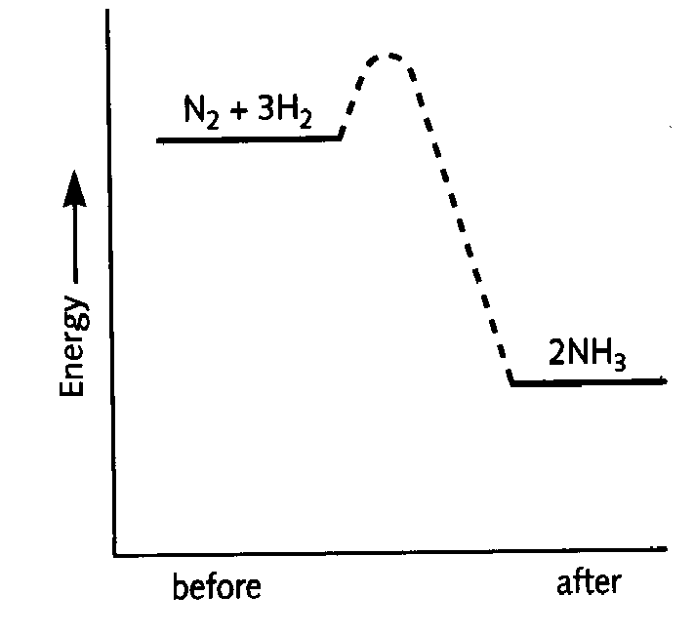
For example… The formation of NH₃
N₂ + 3H₂ → 2NH₃
Does this reaction require a little or a lot of energy to start?
Does this reaction have a positive or negative ΔH?
Is this reaction exothermic or endothermic?

Slide 18
Exit ticket
Which type of reaction needs more activation energy?
2. Explain the sign convention for enthalpy in chemical reactions.

