Slide 1
DO NOW ( Noise level zero)
Have HW out
How much heat is needed to increase the temperature of 50 gm of water by 2
degree Celsius? ( Specific Heat of water is 4.18 Joules per gram per degree
Celsius)
3. Write two differences between heat and temperature.

Slide 2
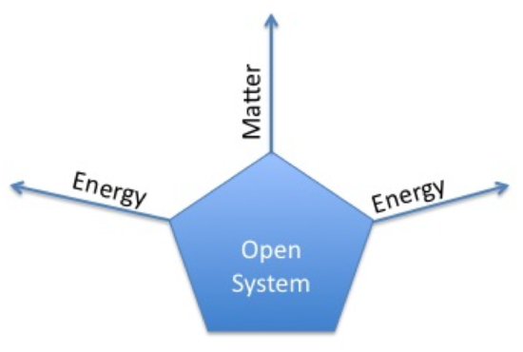
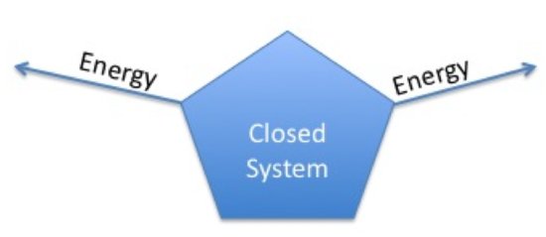
Quick recap : Systems and Surroundings
Open system Closed System

Slide 3
Isolated systems

Slide 4
Specific Heat of Metals Lab

Slide 5
Big Question:
Can you identify this substance??
How can you prove it??

Slide 6
Big Question:
If a heated piece of metal is placed into a beaker containing water at room temperature, where does the metal’s heat go?
Turn and talk ( 45 seconds!) Go!
Let’s hear from you!

Slide 7
What are today’s objectives?
Thermal equilibrium!!
What IS equilibrium?
When two things at different temperatures come into contact( in a closed system), after a while they will have the same final temperature. This is thermal equilibrium.
The two things at different temperatures come into contact, which way does heat flow?
One gains and the other loses the SAME amount of heat.

Slide 8
Read the proposal for the lab : INDEPENDENT
Annotate the Text
1. Highlight, circle or underline important information.
2. Write your comments and questions in the margin.
3. Use symbols to mark the text : ! Interesting ? Confusing
4. Criteria for success: A level 4 will do all of the following:
Annotations are found throughout the reading, equaling about 1 per paragraph.
Keywords AND ideas are highlighted.
Additional questions/interactions with the text are written.
Any responses are written neatly & in complete sentences, is detailed and is written in own words.

Slide 9
Background
In your lab worksheet, fill out the background information from your understanding of the proposed experiment. Take five minutes!!
Work silently, independently.
Do NOT COPY the information. Paraphrase!
Challenge:
Talk to your group and create a one sentence summary of the lab!
2 minutes and 42 seconds. GO!

Slide 10
Safety, safety,safety
What safety issues do you see? Talk to your group and fill out the worksheet.
120 seconds. Go!
What materials are being used? 60 seconds

Slide 11
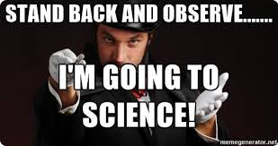

Slide 12
What are YOU going to do?
Move to a position where you can see what I am actually doing
Record the experimental procedure ( step by step) in the worksheet
NOTE your observations and questions on a separate piece of paper/post it

Slide 14
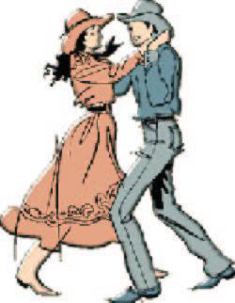
The TWO STEP
How many components does this system have?
Metal and water ( TWO )
How many equations do you think we should have ? ( Turn and talk, 30 sec)

Slide 15
MATERIAL 1 METAL | MATERIAL 2 WATER
GIVEN Mass = Initial temp. = Final temp. = Temperature change = | GIVEN Mass = Initial temp = Final temp = Temp. change = Specific Heat =
REQUIRED Specific Heat | N/A
EQUATION | EQUATION

Slide 16
Looking back to our big question
If a heated piece of metal is placed into a beaker containing water at room temperature, where does the metal’s heat go?
Metal loses heat. Water gains the same heat.
At thermal equilibrium, heat lost by the metal = heat gained by the water
-Q_{m} = Q_{w}
Now we can solve for the specific heat of the metal

Slide 17
Data/Calculations
Record the data in your worksheet
Set up the equation!
Solve for the specific heat of the metal!! ( 330 seconds!! Get started !)

Slide 18
Yes , CER!!
Now that you have a number for the specific heat of the metal sample ( with the proper units, make sure!), try to figure out what metal it could be from the specific heat table.
You will be creating a Claim, Evidence and Reasoning for the identity of the metal. Cite evidence from the lab. Include your method for calculating specific heat in the reasoning section.

Slide 19
More Practice Problems
Let us determine the specific heat of a piece of lead (49.51 grams ). The lead is initially at 100 °C and is transferred to 50 mL water at 24.4 °C. When temperature stabilizes the final temperature of the system is 27.2 °C. Determine the specific heat of lead.

Slide 20
We are going to determine the specific heat of a metal using experimental data from a coffee cup calorimeter:
I
Mass of empty cup | 2.31 g
Mass of cup + water | 180.89 g
Mass of cup + water + metal | 780.89 g
Initial temperature of water | 17.0 °C
Initial temperature of metal | 52.0 °C
Final temperature of system | 27.0 °C

Slide 21
Let us apply the same concept to mixing water at different temperatures!
What would the final water temperature be if 80.0 grams of water at 25°C is combined with 60.0 grams of water at 70°C?

Slide 22
What would the final water temperature be if 100.0 grams of water at 15°C is combined with 50.0 grams of water at 90°C

Slide 23
What would the final water temperature be if 20.0 grams of water at 45°C is combined with 25.0 grams of water at 70°C

