Slide 1
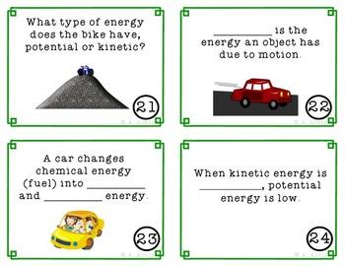
DO NOW
Have your homework out: Energy stories poster + paragraph
Have your homework out: Summit notes
Content Assessment on Wednesday
(Energy Changes in Chemical Reactions)

Slide 2
WELCOME TO DORM-RACING!!
May The Force Be With You!!

Slide 3
FOUR DORMS WILL BE COMPETING FOR THE TITLE TODAY….
GO AHEAD AND FIND YOUR DORMS
YOU WILL BE TEAMS COMPETING AGAINST THREE OTHER DORMS
ARE YOU WONDERING WHERE DID THESE DORM NAMES COME FROM?
THEY ARE RESIDENCE HALLS AT CORNELL U.

Slide 4
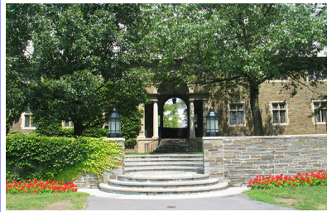
MEWS HALL

Slide 5
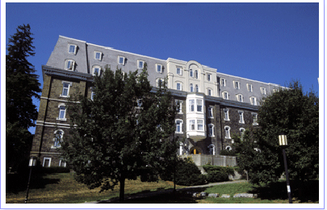
112 EDGEMOOR

Slide 6
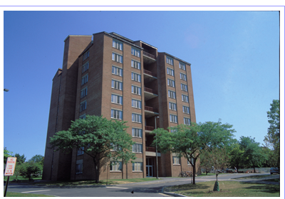
JAMESON HALL

Slide 7
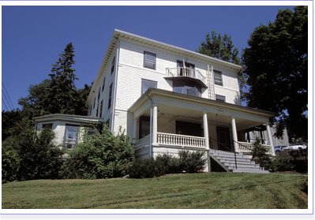
DONLON HALL

Slide 8
RULES OF ENGAGEMENT
ONE Question per dorm!
BUT EVERYONE WORKS ON ANSWERING!!
Be seated , review notes and talk w/ you team(level 2)
Save your work for review
If the first dorm doesn’t get it right, the next dorm gets their turn
The questions will be timed !
Every dorm must choose one person to come up and write the answer on the board.
Scores will be kept
Winning dorm gets to pick a music video to play at the end of the game/class
(pending teacher approval )
LET THE GAMES BEGIN!!

Slide 9
PRACTICE QUESTION 1
When is chemistry tutoring during the week? If you cannot make it to tutoring how should you ask for clarifications for your questions/doubts?
30 s

Slide 10
PRACTICE QUESTION 2
What does Unit 2 talk about in chem? 30 s
Energy
Heat and energy
Combustion
Heat and energy in the earth’s interior
GET READY FOR DORM-RACING!!

Slide 11
QUESTION 1
Look at the pieces of information on the papers. Arrange them to create the general equation for heat flow. Place proper units under each variable.
60 s

Slide 12
QUESTION 2
What is the law of conservation of energy? Give an example of energy transformation in real life.
90 s

Slide 13
QUESTION 3
What is the mathematical form of the first law of thermodynamics? Write the equation and name the variables.
60 s

Slide 14
QUESTION 4
What does it mean to say water has a specific heat of 1 calorie per gram degree Celsius ? Write one sentence.
2 min

Slide 15
QUESTION 5
Calculate the total heat gained by a cup water, weighing 40 grams being heated from 25 to 32 degree Celsius. The specific heat of water is 1 cal/g℃
2 min

Slide 16
QUESTION 6
A metal rod at the room temperature of 25 ℃ was heated on a flame till its temperature changed to 72℃. Calculate Δt.
30 s

Slide 17
QUESTION 7
The _______________ of the universe constantly increases!!
30 s

Slide 18
QUESTION 8
Specific heat of sand is 0.19 cal/ g ℃. The specific heat of water is 1 cal/ g ℃. At noon on a summer day, which one will feel more comfortable?
1 min

Slide 19
QUESTION 9
Specific heat of brass and aluminium are 0.38 J/g ℃ and 0.9 J/g ℃ respectively. Both are heated upto a certain temperature and left to cool down. Which specimen will cool down faster?
1 min

Slide 20
QUESTION 10
What is the energy due to the position of an object? Write down the formula.
30 s

Slide 21
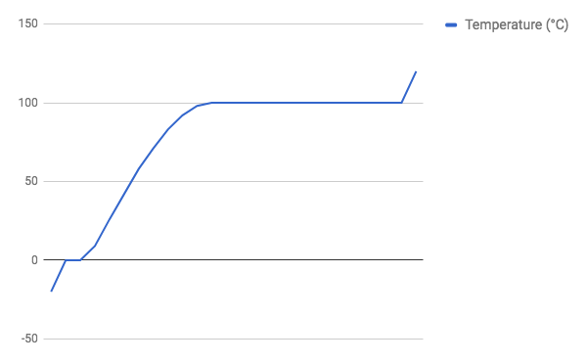
QUESTION 10
Label the different parts of the graph! 2 min

Slide 22
QUESTION 11
Calculate the mass of an object with thermal energy of 250 Joules when it was heated from 32 to 45 degree Celsius. Specific heat of the substance is 0.875 J/ g℃
2 min

Slide 23
QUESTION 12
Calculate the temperature change on a piece of brass weighing 10 g when it was heated, so that its thermal energy was 78 Joules. Specific heat of brass is 0.38 J/g ℃
2 min

Slide 24
QUESTION 13
Solve for x : 3 min
4x + 32-6 = 58
2. 9x = (68/27)+3

Slide 25
QUESTION 14
If a gold ring has total thermal energy of 13 Joules and its mass and temperature change are 5 g and 20 degrees Celsius respectively, what is the specific heat of gold?
2 min.

Slide 26
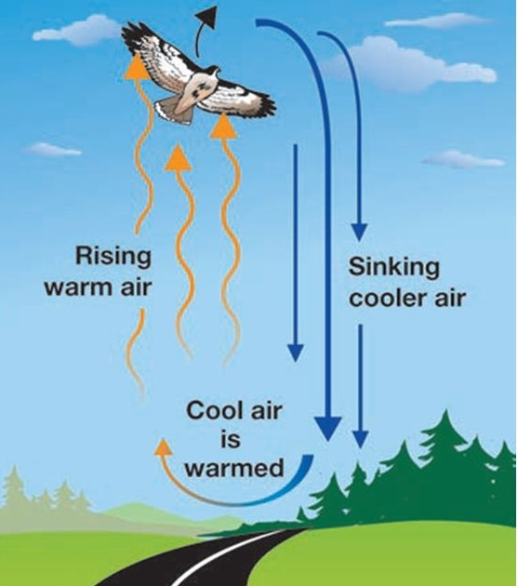
QUESTION 15
Describe the mode of heat transfer:
30 s

Slide 27
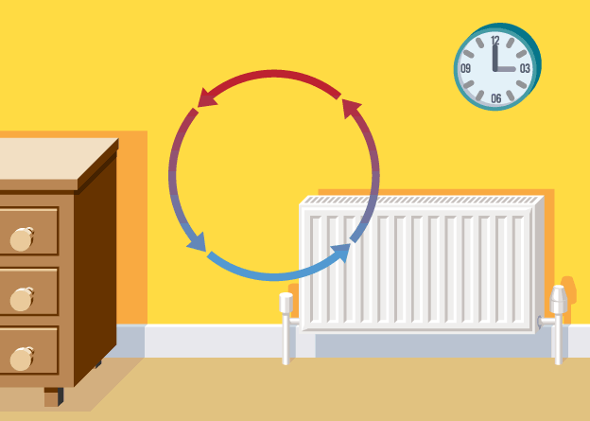
QUESTION 16
Describe the mode of heat transfer:
30 s

Slide 28
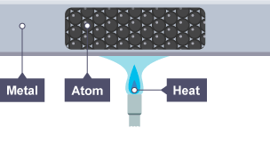
QUESTION 17
Describe the mode of heat transfer :
30 s

Slide 29
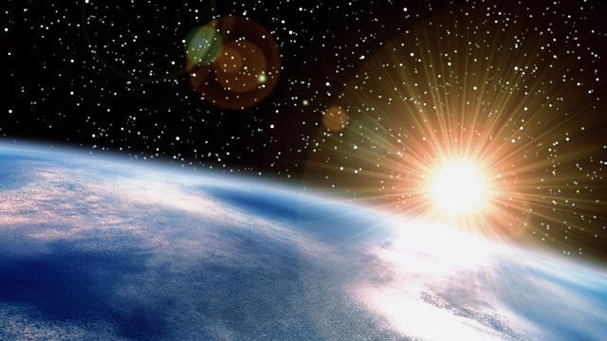
QUESTION 18
Describe the mode of heat transfer :
30 s

Slide 30
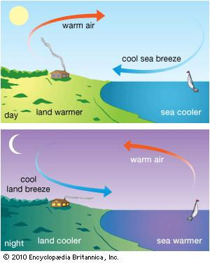
QUESTION 19 :
Specific heat of sand is 0.19 cal/ g ℃. The specific heat of water is 1 cal/ g ℃. Based on this information and your knowledge of heat transfer, what is going on in the diagram below? 2 min

Slide 31
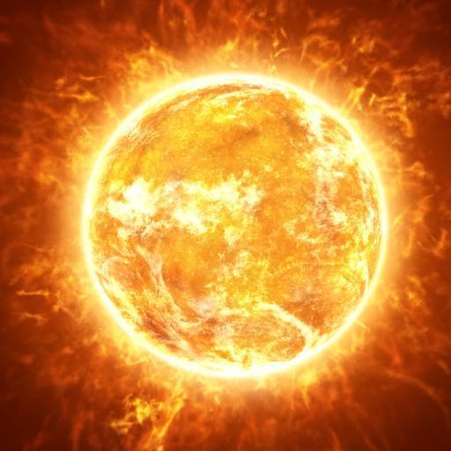
QUESTION 20:
How many forms of energy transformations can you see? 45 s

Slide 32
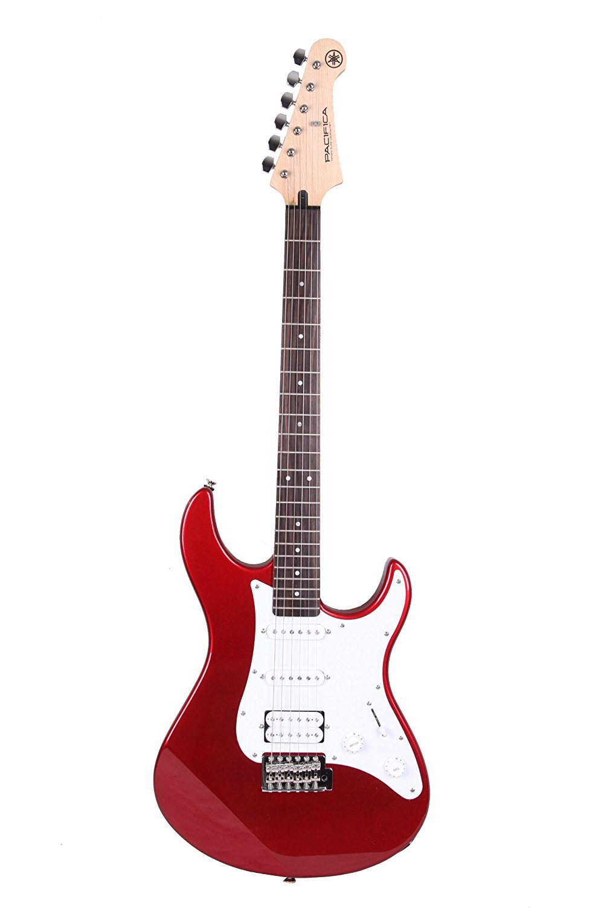
QUESTION 21:
How many forms of energy transformations can you see? 45 s

Slide 33
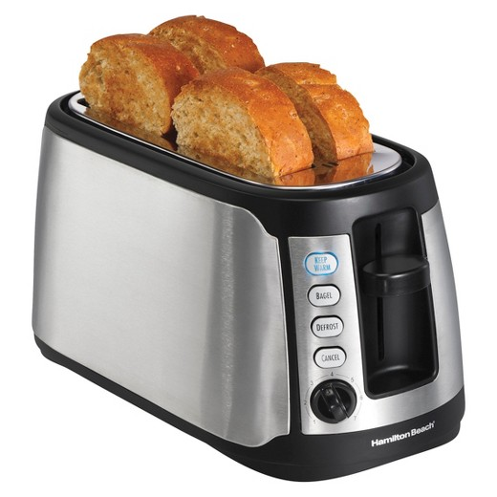
QUESTION 22:
How many forms of energy transformations can you see? 45 s

Slide 34
QUESTION 23:
How many forms of energy transformations can you see? 45 s

Slide 35
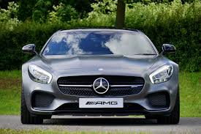
QUESTION 24:
How many forms of energy transformations can you see? 45 s

Slide 36
QUESTION 25:
Draw and label an exothermic reaction energy diagram. 1 min

Slide 37
QUESTION 26:
Draw and label an endothermic reaction energy diagram. 1 min

Slide 38
QUESTION 27
Describe the steps of energy transformation starting from you eating an ice cream for breakfast in the morning till the end of the day when you go to sleep.
1 min

Slide 39
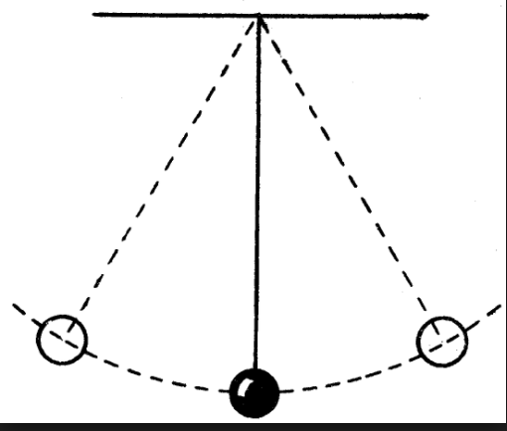
QUESTION 28
What kind of energy transformations do you see in a pendulum? Label the diagram below using formulae: 45 s

Slide 40
QUESTION 29
Convert 90 degree Farenheit to Celsius using the formula C/5 = (F-32)/9
2 min

Slide 41
QUESTION 30
According to the zeroth law of thermodynamics, if we mix two samples of water at 30 and 80 degrees Celsius, what will be a good guess for the final temperature of the mixture after it has reached thermal equilibrium?
1 min

Slide 42
QUESTION 31
Identify the mistakes in the following statement:
A system had 300 calories of total internal energy. It lost 120 calories when it performed some work. It also received newly created electrical energy from a brand new transformer nearby, making the change in its internal energy a magnitude of 120 calories.

Slide 43
QUESTION 32
A 10 kg piece of zinc at 71 ºC is placed in a container of water. The water has a mass of 20.0 kg and has a temperature of 10.0ºC before the zinc is added. What is the final temperature of the water and zinc?
Set up your equation. You do not have to solve the equation.
5 min

Slide 44
SEMESTER 1 CHEM PROJECT
You will be working as an U.S.G.S Seismologist to create a report on the causes of earthquakes and to calculate the probability of the ‘next big one’.The project has four parts.
Heat Transfer Lab : You will be developing your own hypothesis and experimental design, carry out the lab, analyse your data and create a summary report for part 1.
Earth Composition Lab : You will be creating a mathematical model for the earth’s internal structure using earthquake data. The Final Product will be a data analysis report, a diagram of the earth’s layers, a diagram of a normal, reverse and strike slip fault and a summary report for part 2.

Slide 45
SEMESTER 1 CHEM PROJECT
3. Calculating the energy of earthquakes and binomial probability of ‘ the next big one’.Summary Report for part 3.
4. Article analysis (3) and Final Report.

Slide 46
Entropy video

Slide 47
Entropy Video

Slide 49
Read and annotate the text : Entropy and the second law of thermodynamics
Fill out the worksheet as you go through the text.
Be ready to answer questions.
You have 5 minutes and 10 seconds.

Slide 50
Calculations for total Heat Energy
We will go through the solved problems.
Complete Sample question 2.
Time : 5 minutes and 30 seconds.

Slide 51
Calculations for Final Temperature
What would be the final water temperature if 80 grams of water at 25 degree C is combined with 60 grams of water at 70 degree C?

Slide 52
Calculations for Final Temperature
What would be the final temperature of water if 100 grams of water at 15℃ is combined with 50 grams of water at 90℃

Slide 53
Read Heat Transfer Lab directions
Your homework is to complete experimental design and your hypothesis.
You will be working together as a table group.
Bring them back on Friday to get teacher approval and carry out the lab.
Your data must be recorded first on your lab notebook, where you should create a short lab report ( Title, materials, procedure, data table ). From your notebook, you will transfer the data to your project report.

