Slide 1
Table 2
Jonathan A
Emily D
Alex M
Lily P
Table 3
Juan H
Kimberly B
Stephanie G
Leslie A
PERIOD 1
Table 7
Emilio L
Nick R
Rocio S
Adrian C
Table8
Aaron R
Victor M
Berenice R
Matthew I
Table 5
Manny F
Victor B
Lizbeth T
Gabriel C
Table 6
Maria A
Fernie H
Ashley M
Stephanie S

Slide 2
DO NOW
Identify the objects that gain / lose heat in the following scenarios. What is the system and what is the surrounding?
a. The human body digests a candy bar.
b. A hiker warms his hand by the campfire.
c. Acetone evaporates at room temperature from a glass beaker
d. Two samples of water are mixed. Sample A has a higher temperature than
Sample B.

Slide 3
Agenda:
Do Now
Do Next on weebly
HW : Summit Focus Area 2 worksheet ( go through resources on objective 1,3)
SWBAT create a mathematical model of the earth’s interior and analyze the pattern they see in the data.
Heat Transfer lab if done.

Slide 4
Heat Transfer Lab
If your group changed and you already have some data, share and use the data with your new group. Complete the remaining trials with your new group
Book your lab time with Ms. G
Times available : Lunch or advisory ( with your advisory teachers’ permission)
EMAIL FIRST!!

Slide 5
Earth Composition Lab
Background: The simplest solution to the question “What is beneath our feet” is a homogeneous Earth, or one comprised entirely of the rock we see at the surface. Since seismic waves travel through Earth, they make a useful tool to “probe” the inside of Earth to discover what might actually be inside.

Slide 6
Earth Composition Lab
Task: Your task is to help test if Earth is homogeneous by analyzing a set of seismograms from a single earthquake to determine how long it actually takes for the seismic waves released from an earthquake to arrive at various points on Earth’s surface.

Slide 7
Earth Composition Lab
Implications: If your findings match the findings of the theoreticians then Earth is homogeneous or all rock throughout. However, if your observations do not match the theoreticians’ findings, than we can reasonably assume that the Earth is not homogenous or made entirely of rock and will need to develop a new model.

Slide 8
What is inside ??

Slide 9
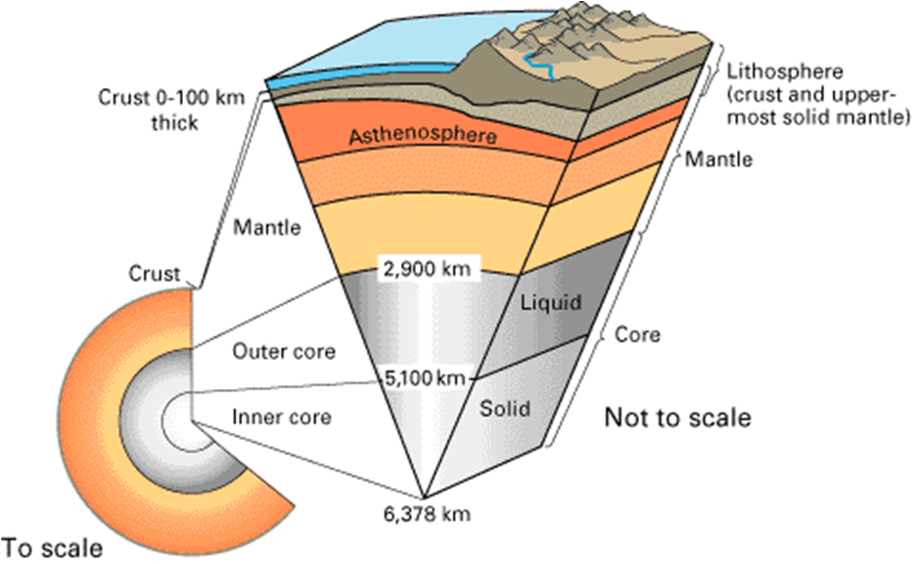

Slide 10
A brief recap
What layer of the earth provides the heat for mantle convection?
How does convection in the mantle create earthquakes?
What are the 2 different types of body waves produced in a quake?
Which one strikes first? Which strikes next?
Describe their movement.

Slide 11
How do you know what is inside? Turn and talk!!

Slide 12
Earth Composition Lab
Applying Occam’s razor

Slide 13
Seismologists Vs Theoreticians
It is up to you to prove the earth has many layers….
Every table group will select 2-3 Theoreticians and 1-2 seismologists.
Seismologists will work with real data from the Haiti earthquake
Theoreticians will predict wave travel times assuming uniform speed of P-waves.

Slide 14
The Haiti Earthquake

Slide 15
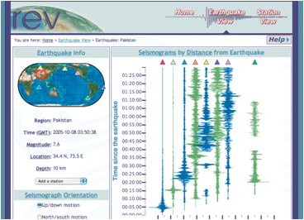
Seismologists : Take a look at the worksheet & graph
Your task is to help test this hypothesis by analyzing a set of seismograms from a real earthquake to determine how long it takes for the seismic waves released from an earthquake to arrive at various points on
Earth’s surface.

Slide 16
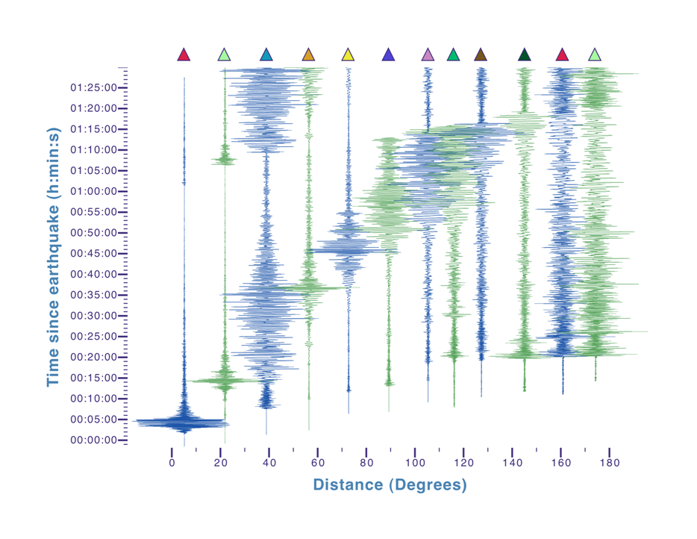

Slide 17
Check your understanding….
What will the seismologists be studying?
What observations will you be noting down?

Slide 18
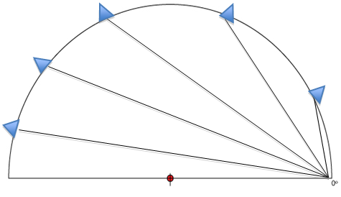
Theoreticians
Your task is to help test this hypothesis by creating a model of the Earth, using the known velocity of seismic waves in rock ~ 11km/s to predict how long it should take seismic waves to reach various distances around Earth

Slide 19
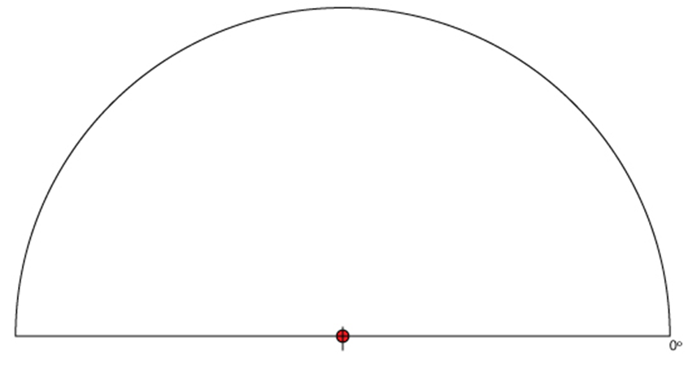

Slide 20
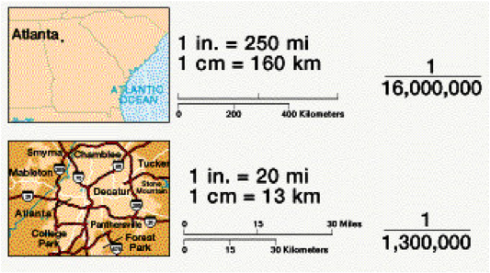
Scale and proportion
In maps

Slide 21
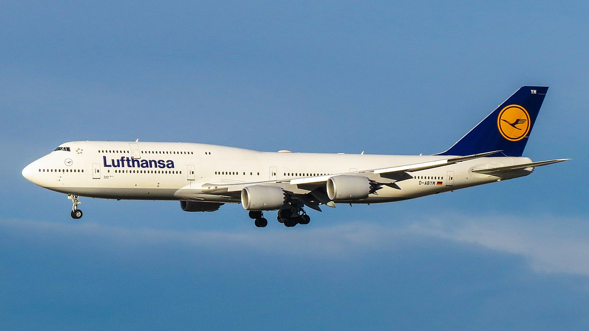
In models

Slide 22
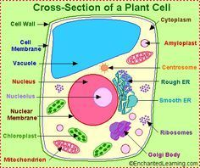
In microscopes

Slide 23
Scale and proportion...
The actual radius of the earth is 6371 Km
Can you calculate the scale of your model from this data?

Slide 24
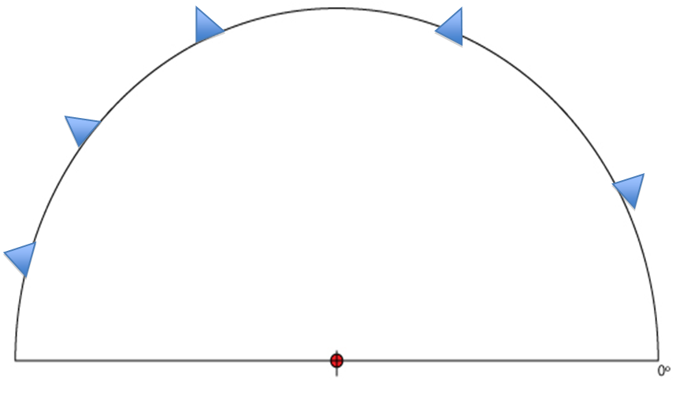

Slide 25
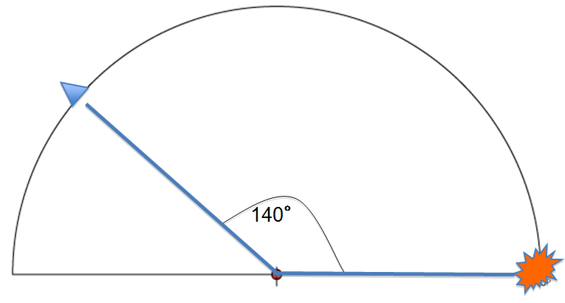

Slide 26
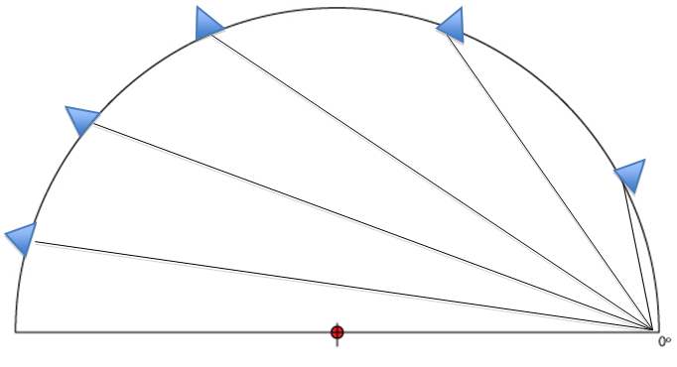

Slide 27
Check your understanding….
Describe how you will be filling out the following data table:

Slide 28
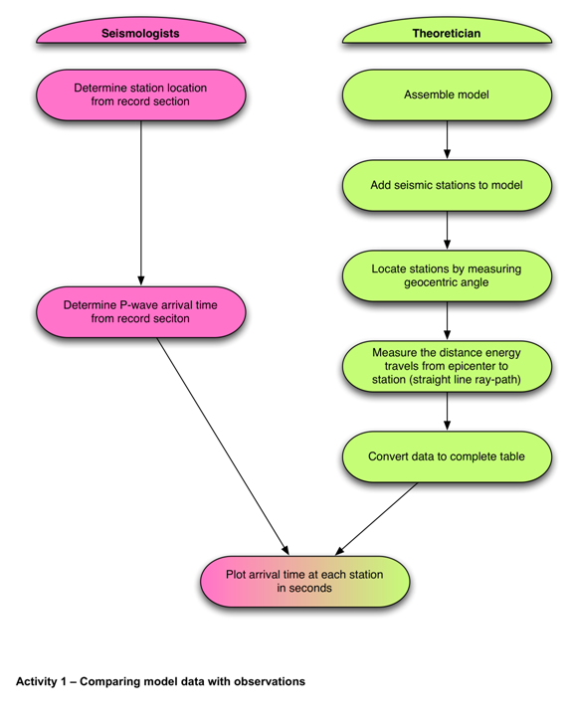

Slide 29
Data
When you have gathered both sets of data, give them to your instructor to be entered into a spreadsheet.
Compare observed vs predicted p wave arrival times.

Slide 30
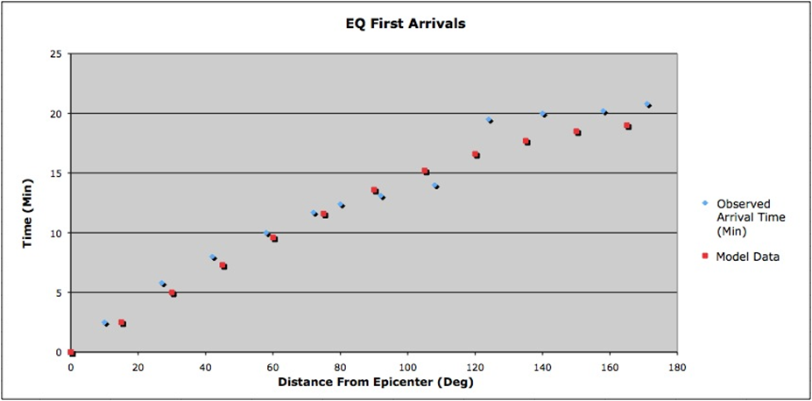

Slide 31
Data Analysis
Does observed and predicted data show the same trend?
What does that imply?
Describe how the observed and predicted arrival times differ on the graph
What is you conclusion based on the data?

Slide 32
HOMEWORK :::: ::::Summit Focus Area 2
Go through the resources listed for objectives 1 and 3
Complete the worksheet on Weebly ( Due Thursday)
Take Content Assessment
Complete Focus Area 1 and 2 by Friday ( 10/27)

