Slide 1
DO NOW
Write down the first law of thermodynamics
( mathematical as well as conservation of energy)
2. What is the general equation for heat flow? Write the equation with units.
3. What are the different modes of heat transfer? Write one sentence about each.

Slide 3
Entropy and the second law
Answer the thinking questions : Work independently!! Use Extra sheet of paper
( 5 min 30 sec )
Let’s hear from you!
Read and annotate the text in your Packet : Work independently!!
(5 min 45 sec)

Slide 4
Entropy Video : Record your observations/questions

Slide 5
Plate Tectonics: Record your observations/questions

Slide 6
Part B:
Complete YOUR responses ( 4 min 55 sec) INDEPENDENT
Discuss with your partner. Record THEIR responses. ( 3 min 26 sec ) COLLABORATIVE
Now we will discuss together. WHOLE GROUP
Notes:
Start heating water!!!!

Slide 7
Entropy levels
Solids
Liquids
Gases

Slide 8
Demo
Entropy, temperature, kinetic energy, molecules!!!
Link them up to make a story about the second law of thermodynamics!!
Partner up and discuss together.

Slide 9
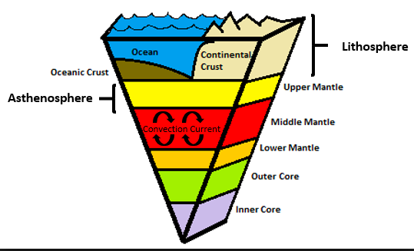
Going back to the Text on Entropy and Second Law
Think:
As the layers move from a state of order to disorder energy is released.
This energy can be expressed as earthquakes on the surface

Slide 10
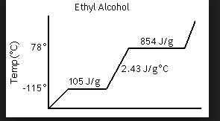
Complete Part C : Work independently
Please correct the ethyl alcohol/ethanol heating curve:

Slide 11
Part C: Group Discussion
Heating ethyl alcohol or ethanol
2. Sugar dissolving in water.
3. Burning wood
4. Making popcorn

Slide 12
Bring out your Project Packet ( Part 1)
Read the text independently once again and see if it makes better sense this time!
( 3 min 30 sec)
What’s the general equation for heat flow again?
PROBLEM SOLVING TIME!!

Slide 13
Calculations for Total Heat
What is the total amount of heat energy, in joules absorbed by 56.0 grams of water when the temperature of the water increases from 5.0°C to 24.0°C?

Slide 14
Calculations for Total Heat
Find the heat energy released when 120.0 grams of water decreases temperature from 73.0°C to 40.0°C?

Slide 15
Calculations for Final Temperature
What would be the final water temperature if 80 grams of water at 25 degree C is combined with 60 grams of water at 70 degree C?

Slide 16
Calculations for Final Temperature
What would be the final temperature of water if 100 grams of water at 15℃ is combined with 50 grams of water at 90℃

Slide 17
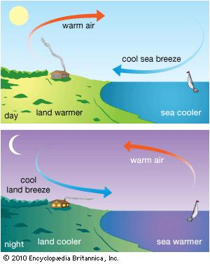
Homework
Specific Heat CER
Looking for:
Proper citing of evidence (text +data)
Proper explanation of EACH evidence
Break it down.
What does it mean to say
specific heat of x id 0.5 g/J℃
5. Use sentence stems
6. Reasoning should be a minimum of 5-7 sentences. Use Sentence Stems.

Slide 18
Let’s review!!
Go to www.kahoot.it

