Slide 1
DO NOW
What is energy? What are some forms of energy you see everyday?
Which units do we use to measure heat/ thermal energy?
3. Write one difference between heat and temperature.
DO NEXT on Weebly

Slide 2
Unit 1 Test Debrief

Slide 3
Unit 2
THERMODYNAMICS
HEAT AND ENERGY IN THE EARTH’S INTERIOR

Slide 4
Be prepared to take notes!!
Notes go into your binders ( on college ruled paper) or a notebook ( preferably NOT your lab notebook !!) if you are using one

Slide 5
Vocabulary Worksheet
Please fill in as you encounter each word in class
(discussions, powerpoints, assignments, readings etc.). Goes in your binder ( notes )

Slide 6
WHAT CAUSES EARTHQUAKES & VOLCANOES?

Slide 9
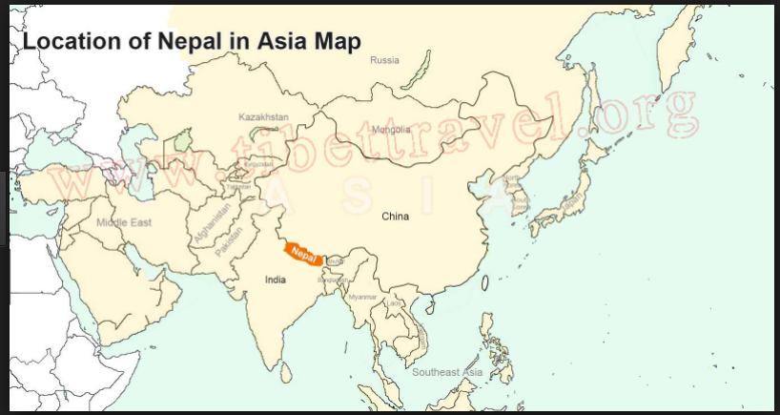

Slide 11
What are some observations and questions you have from these videos?

Slide 12
Pinpointing the actual cause of earthquakes/volcanoes
Thermo Dynamics
Heat Movement
Earthquakes are measured by seismographs
The scale is called the Richter Scale

Slide 13
The General Equation for Heat Flow

Slide 15
What is heat?

Slide 16
What is temperature?

Slide 17
SPECIFIC HEAT!!
WHAT IS THAT?
WHAT UNITS DO WE USE FOR IT?
TAKE OUT THE Q = MCAT WORKSHEET THAT YOU HAD FOR HOMEWORK

Slide 19
MATH TIME
FOLLOW FORMAT
NUMBERS WITHOUT UNITS ARE MEANINGLESS
You will not get credit on assignments without proper units.
For all values in chem, follow format :: number,unit , chemicals/energy.
Examples: 3 gms of gold, 2 Kilo Joules of thermal energy, 4.184 Joules per gram degree Celsius Specific Heat (water)
GIVEN | REQUIRED | SOLUTION

Slide 20
Worksheet Problems
Complete the worksheet based on the sample problems worked out in class today.
Due on Tuesday

Slide 21
ZEROTH LAW OF THERMODYNAMICS
WHICH WAY DOES HEAT FLOW????????

Slide 22
There is no such thing as cold. Only heat or absence of heat.
READ AND TAKE NOTES
https://tinyurl.com/y9a5txec
What are some questions, comments and confusions??

Slide 24
HOMEWORK
Complete worksheet ( due Tuesday)
SUMMIT LEARNING
Energy changes 1 : Objectives 1,2,3 ( due next Friday ). Create notes on ALL readings ( minimum three pages ).
Notes format : check previous powerpoint ( modified Cornell Notes )
3. CER (due Tuesday)

Slide 25
Exit Ticket
How much heat does 50 gm water hold, when its temperature rises from 25 to 30 degree Celsius ? Use calories for your calculations.
Specific heat of water is 4.184 Joules or 1 calorie per gram ( degree Celsius ).

