Slide 1
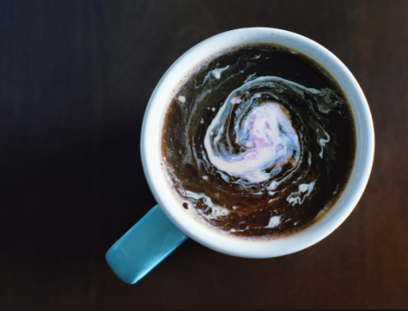
DO NOW
1.Talk about entropy in a coffee cup.
2. Identify the mistakes in the heating curve!!

Slide 2
Agenda
Write Agenda/ Homework on Planner
Classroom norms
2017 Nobel Prize Winners
Specific Heat CER exemplar
Final temperature problems
Pre lab: heat transfer
Homework : Complete Proposal and hypothesis. Review for Interims.

Slide 3
NORMS…...
READY..it’s not just a word
RESET
Enter class silently, ready to learn. Stow backpacks under table and start working. Merits for those conforming to the norms
Do not talk out of turn. Raise your hand to speak. Listen to your peers
Keep your volume at level 2 during collaborative work. Independent work is SILENT
Always, always ask questions
Attend tutoring!!

Slide 4
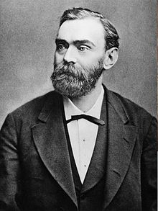
Alfred Nobel

Slide 6
A Claim, Evidence, Reasoning that is…….

Slide 7
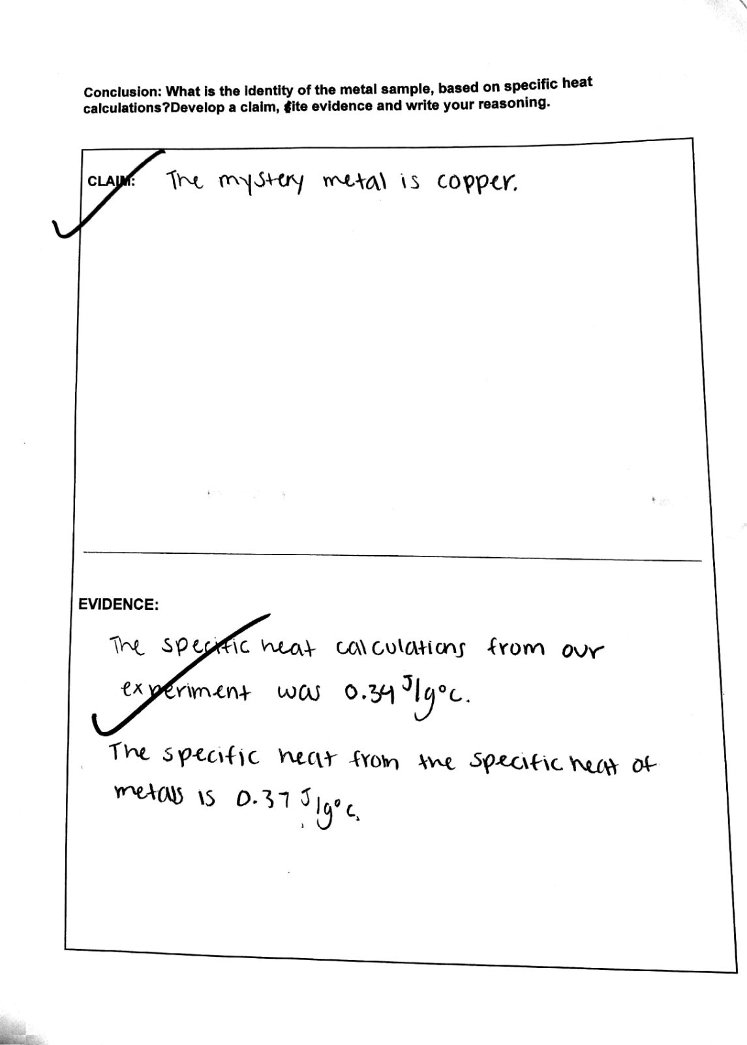
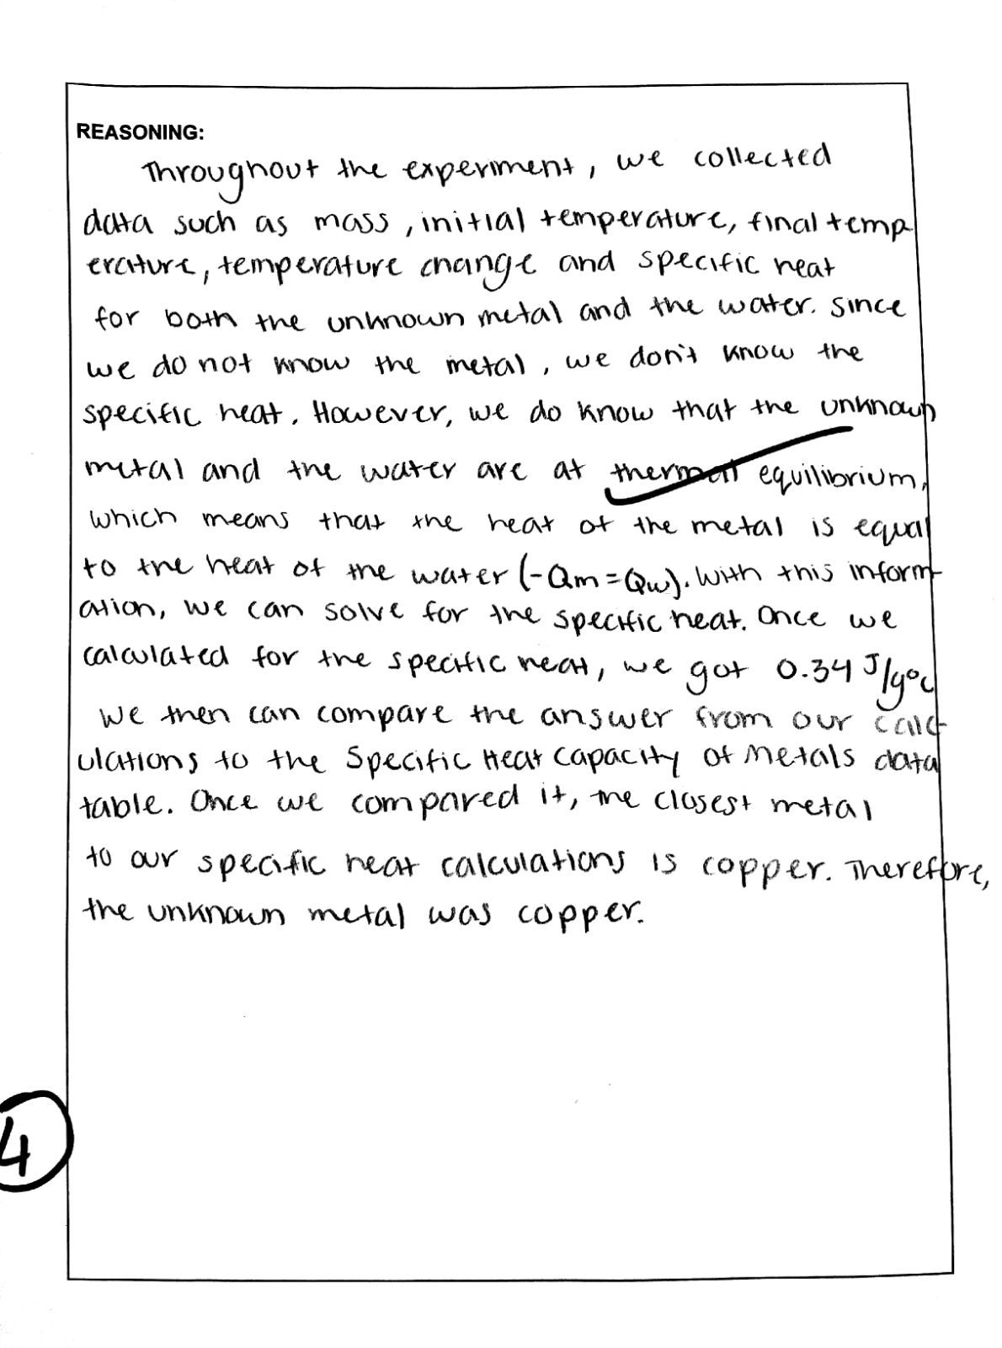

Slide 8
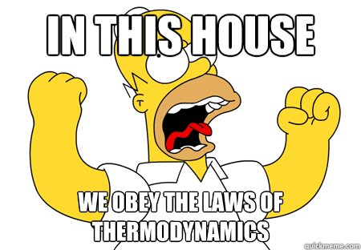

Slide 9
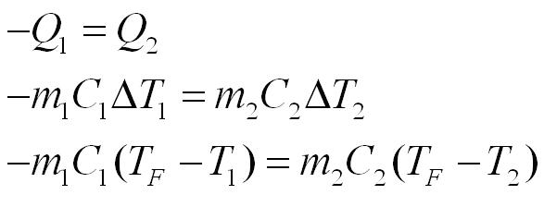
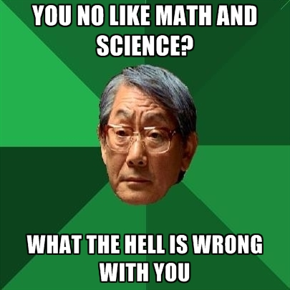

Slide 10
Determine the final temperature when 32.2 g of water at 14.9 °C mixes with 32.2 grams of water at 46.8 °C.

Slide 11
2. Determine the final temperature when 45.0 g of water at 20.0 °C mixes with 22.3 grams of water at 85.0 °C.

Slide 12
​3. Determine the final temperature when 30.0 g of water at 8.00 °C mixes with 60.0 grams of water at 28.2 °C

Slide 13
HEAT TRANSFER PRE- LAB
COMPLETE PART A ( THINKING QUESTIONS)
…………………..5 MINUTES AND 28 SECONDS
INDEPENDENT WORK
YOU ARE WORKING SILENTLY

Slide 14
Read MANTLE CONVECTION : INDEPENDENT
Annotate the Text
1. Highlight, circle or underline important information.
2. Write your comments and questions in the margin.
3. Use symbols to mark the text : ! Interesting ? Confusing
4. Criteria for success: A level 4 will do all of the following:
Annotations are found throughout the reading, equaling about 1 per paragraph.
Keywords AND ideas are highlighted.
Additional questions/interactions with the text are written.
Any responses are written neatly & in complete sentences, is detailed and is written in own words.
Notes:
4 MIN 20 SEC

Slide 15
PART B : COLLABORATIVE
In your groups, answer the guiding questions
Use notes, powerpoints, readings and project information packet
(Everyone must write their own answers)
7 minutes and 25 seconds

Slide 16
EXPERIMENTAL DESIGN
COLLABORATIVE : WORK IN YOUR LAB GROUPS
DECIDE : MASS OR DELTA T?
DECIDE: PROTOCOL
DECIDE: HYPOTHESIS
GET APPROVAL!!!

Slide 17
Example : Testing the effect of mass
We would like to test water at approximately 5 degrees and 80 degrees Celsius.
In trial 1 we will mix 10 grams of cold and 30 g hot water.
In trial 2 we will test 20 g cold and 20 g hot water
In trial 3 we will test 30g cold and 10g hot.

Slide 18
Example: Testing the effect of temp change
We would like to test 10 grams of cold water and 30 grams of hot water.
In trial 1 we will test cold water at 5 degrees and hot water at 80 degrees Celsius.
In Trial 2 we will test cold water 10 degrees and hot at 80 degrees C.
In Trial 3 we will test cold water at 20 degrees and hot at 80 degrees C.

Slide 19
HOMEWORK : PROJECT REPORT ( PART 1)
START : PROJECT INTRO
COMPLETE:
LAB PROPOSAL
2. HYPOTHESIS
3. Final temperature problems on weebly

Slide 20
More practice….
What would the final water temperature be if 80.0 grams of water at 25°C is combined with 60.0 grams of water at 70°C?

Slide 22
#9
What would the final water temperature be if 100.0 grams of water at 15°C is combined with 50.0 grams of water at 90°C

Slide 24
#10
A person who eats 2400 food calories (2400 Calories) each day consumes 1.0 *107J of energy in a day. That amount of energy could raise the temperature from 0 °C to 100 °C for how much water?

Slide 26
#11
A 4.2 g lead bullet moving at 275 m/s strikes a steel plate and stops. The specific heat of lead is 130 J/Kg °C. If all the kinetic energy is converted to thermal energy and none leaves the bullet, what is its temperature change?

